Slide 1
Logic Design
Combinational Logic

Slide 2
Combinational Logic
The output of the circuit at any time is determined directly from the present combination of inputs
operation fully specified logically by a a set of Boolean functions
Design Procedure:
The problem is stated
The number of available input variables and required output variables is determined
The input and output variables are assigned letter symbols
The truth table is derived
The simplified Boolean function for each output is obtained
The logic diagram is drawn
Design objective: to minimise number of gates, number of inputs to a gate, propagation time through the circuit, number of interconnections

Slide 3
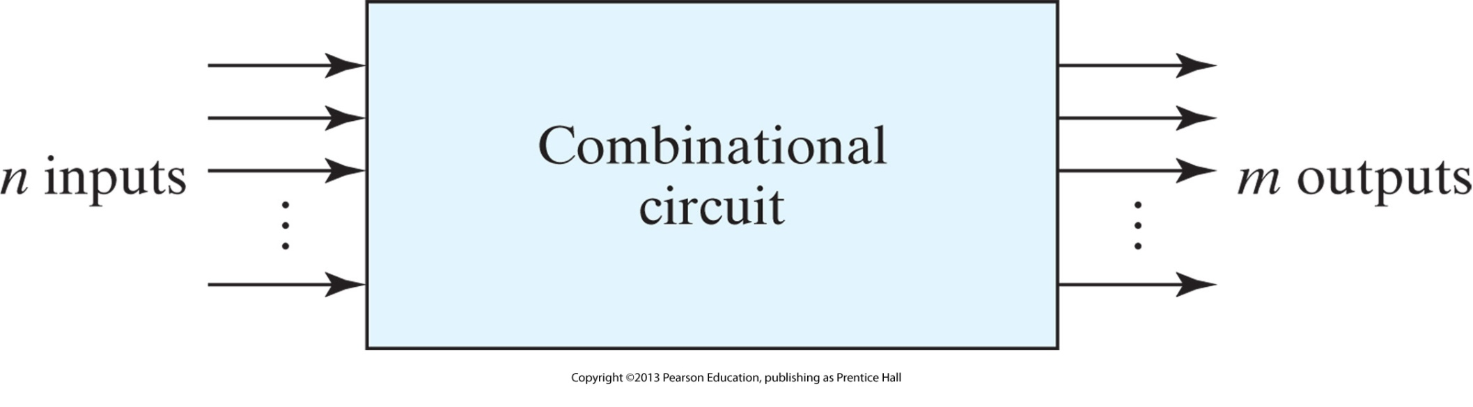
Block diagram of combinational circuit
The diagram of a combinational circuit has logic gates with no feedback paths or memory elements

Slide 4
Obtaining output Boolean functions
To obtain the output Boolean functions from a logic diagram, we proceed as follows:
Label all gate outputs that are a function of input variables with arbitrary symbols— but with meaningful names. Determine the Boolean functions for each gate output.
Label the gates that are a function of input variables and previously labeled gates with other arbitrary symbols. Find the Boolean functions for these gates.
Repeat the process outlined in step 2 until the outputs of the circuit are obtained.
By repeated substitution of previously defined functions, obtain the output Boolean functions in terms of input variables.

Slide 5
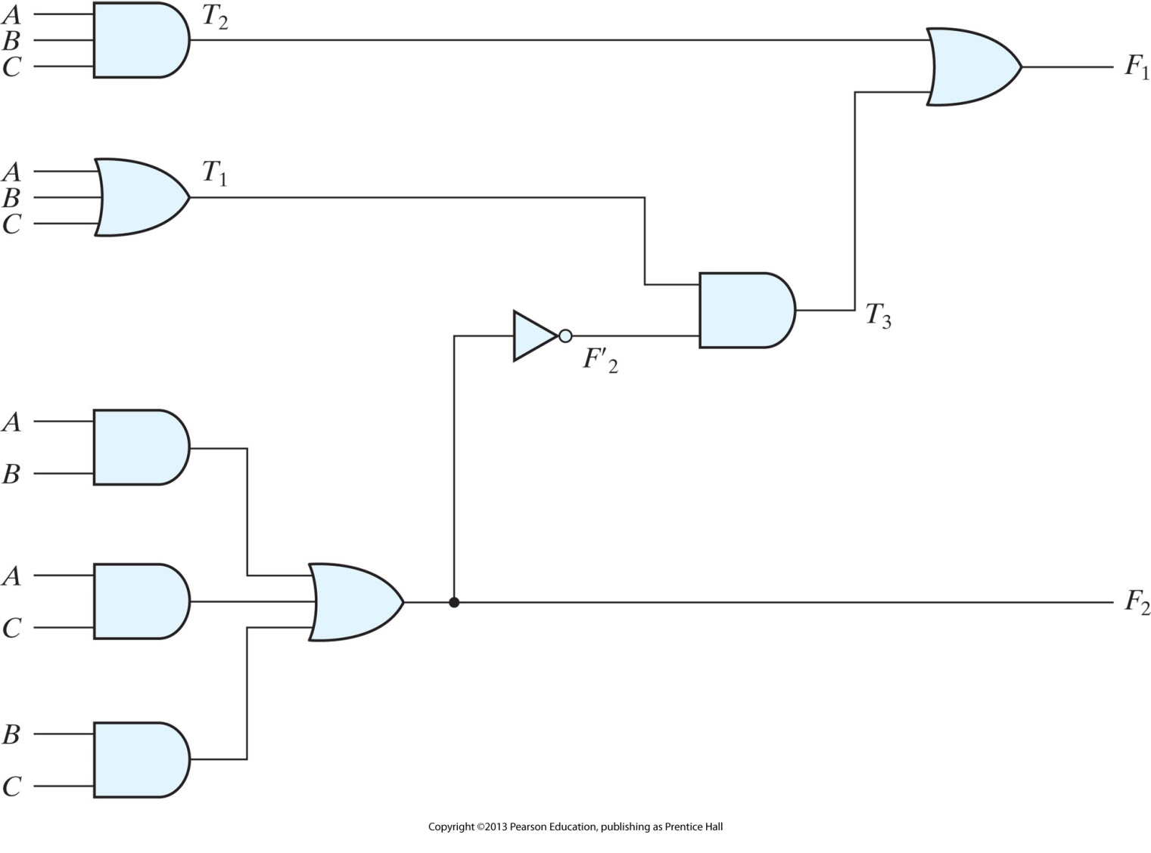
Example
F2 = AB + AC + BC T1 = A + B + C
T2 = ABC
T3 = F’2 T1
F1 = T3 + T2
F1 = T3 + T2 = F’2 T1 + ABC = (AB + AC + BC)(A + B + C) + ABC = (A’+ B’) (A’ + C’) (B+ C’)(A + B + C)+ ABC = (A’+ B’C’) (AB+ AC’ + BC+ B’C)+ ABC = A’BC+ A’B’C’+ AB’C’+ ABC

Slide 6
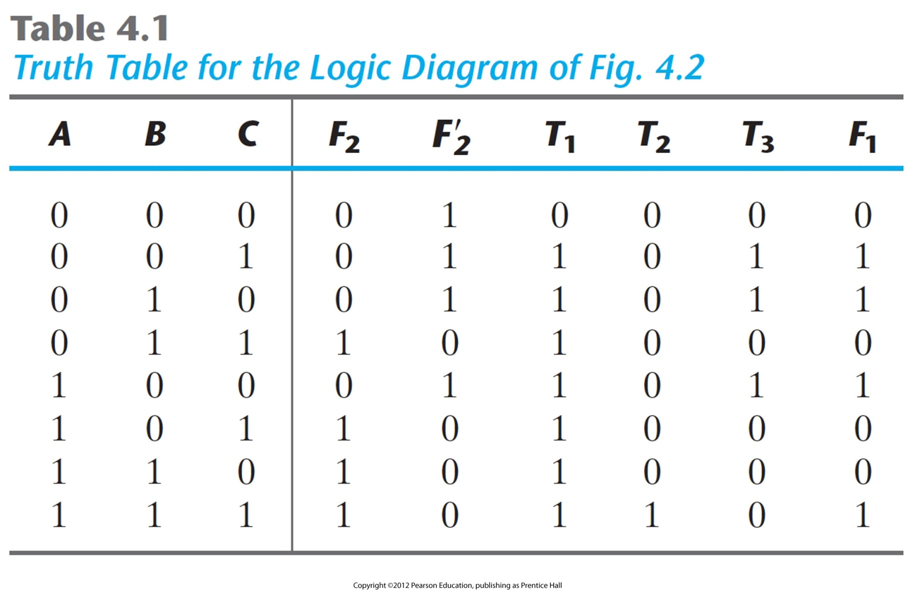
Example

Slide 7
Design Procedure
From the specifications of the circuit, determine the required number of inputs and outputs and assign a symbol to each.
Derive the truth table that defines the required relationship between inputs and outputs.
Obtain the simplified Boolean functions for each output as a function of the input variables.
Draw the logic diagram and verify the correctness of the design (manually or by simulation).

Slide 8
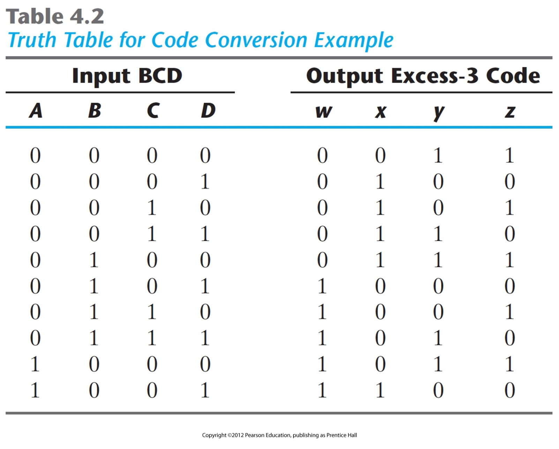
Example: BCD-to-excess-3 code converter

Slide 9
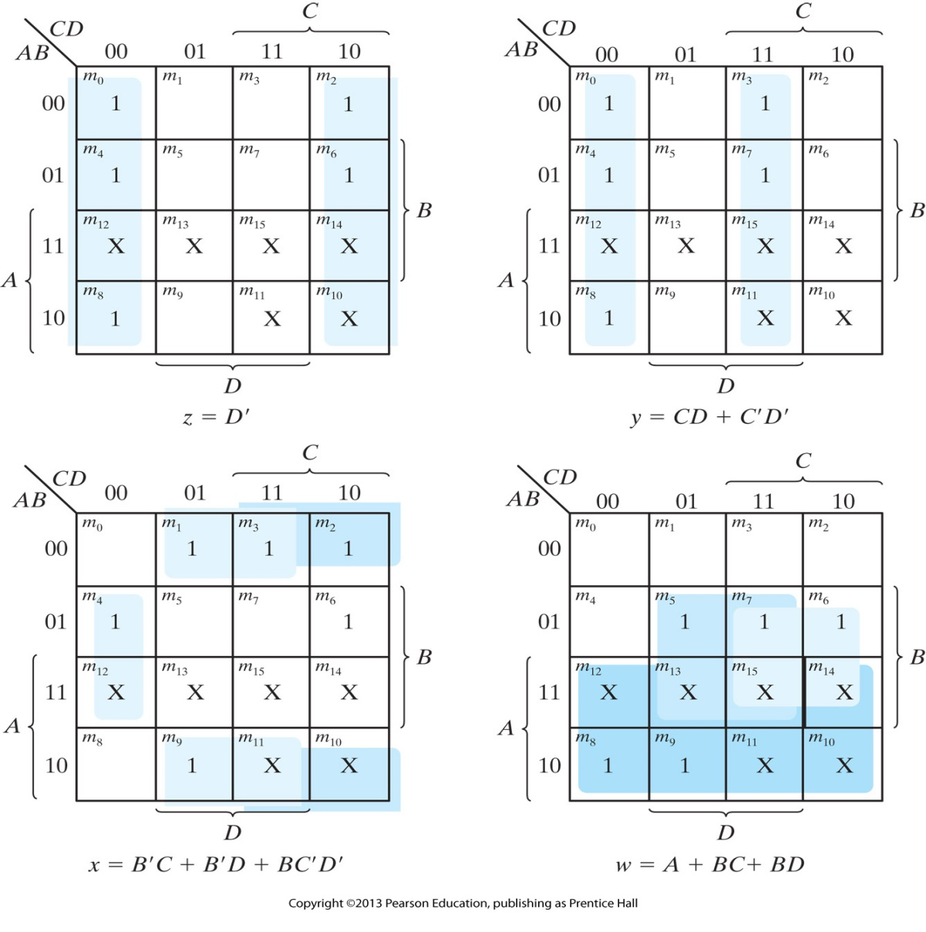
Maps for BCD-to-excess-3 code converter

Slide 10
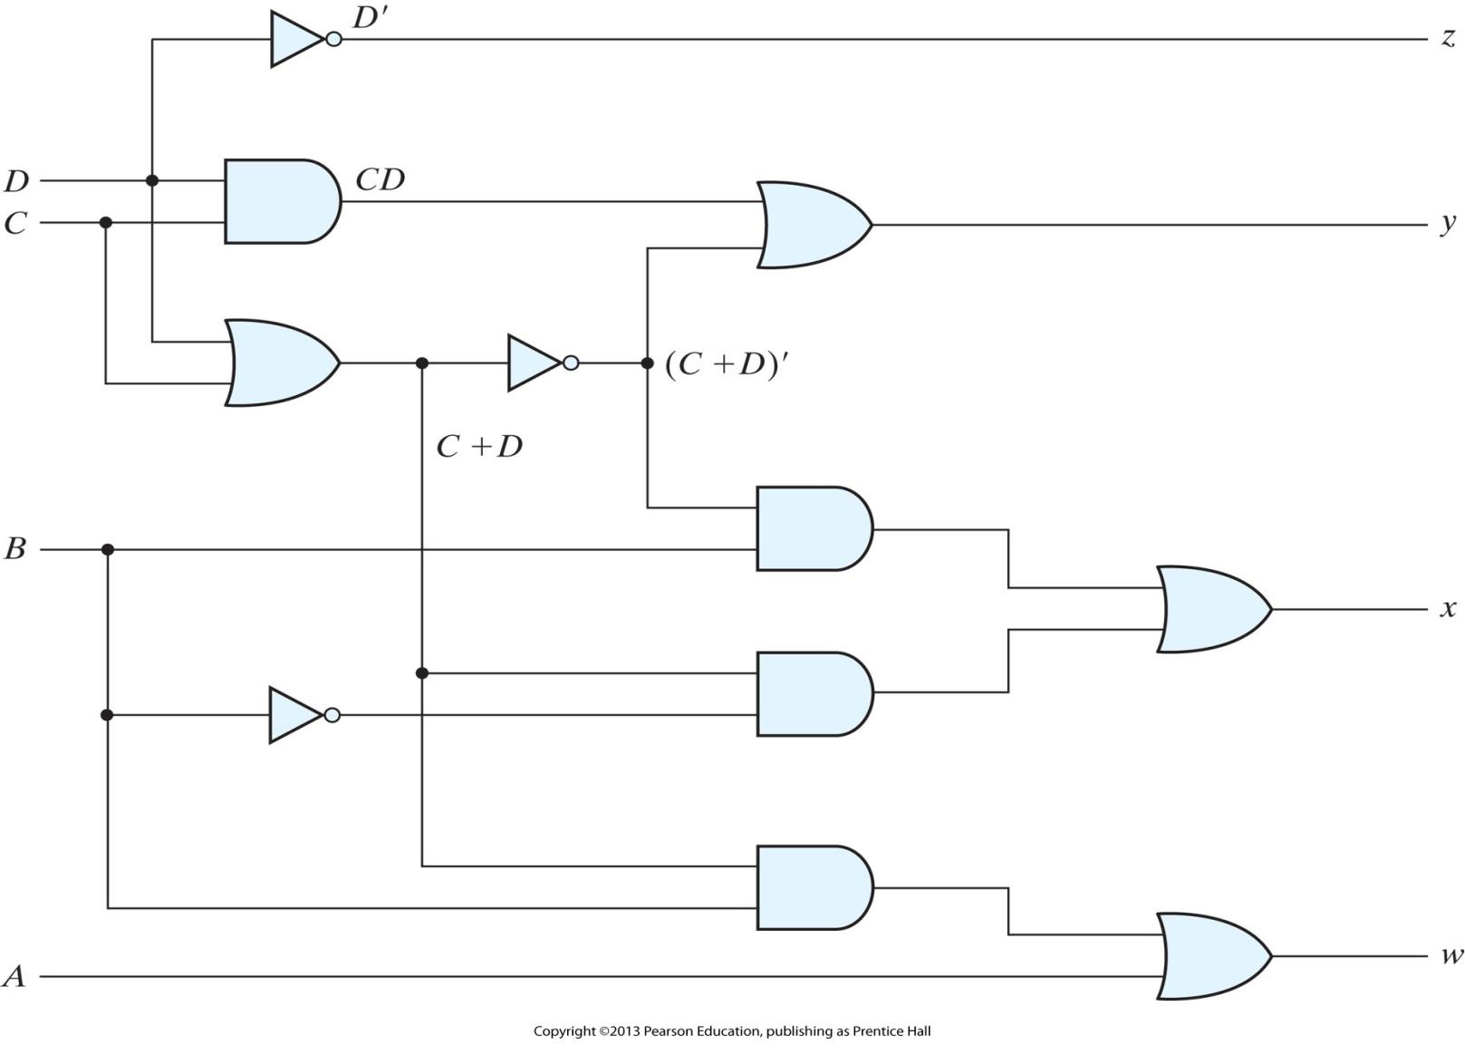
Logic diagram for BCD-to-excess-3 code converter

Slide 11
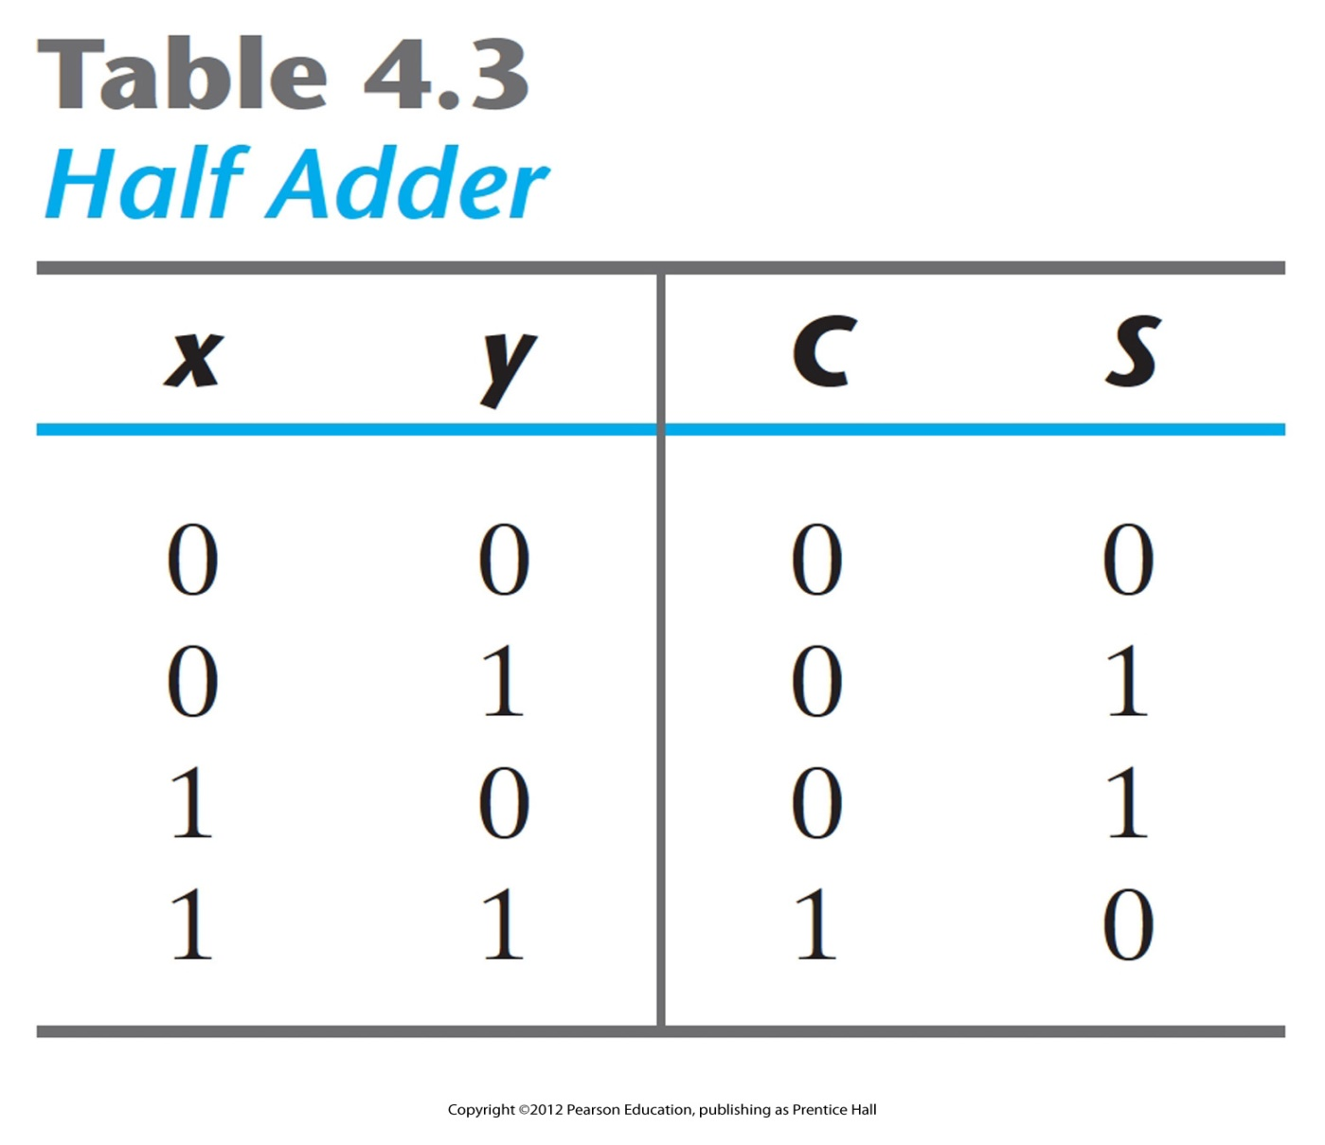
Half Adder

Slide 12
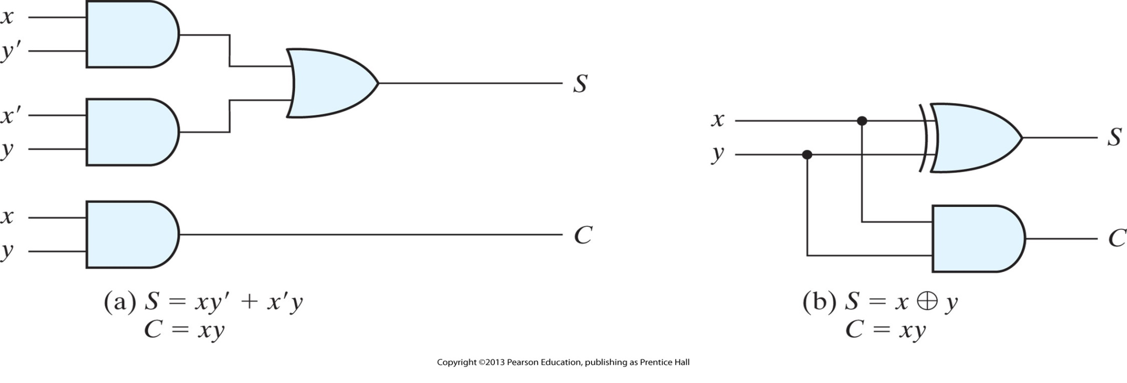
Implementation of half adder
By replicating 1-bit adder, a ripple carry adder is constructed. In the worst case the carry has to ripple all the way from the rightmost bit to the leftmost bit
Q: Can you think of a way to built a faster adder?

Slide 13
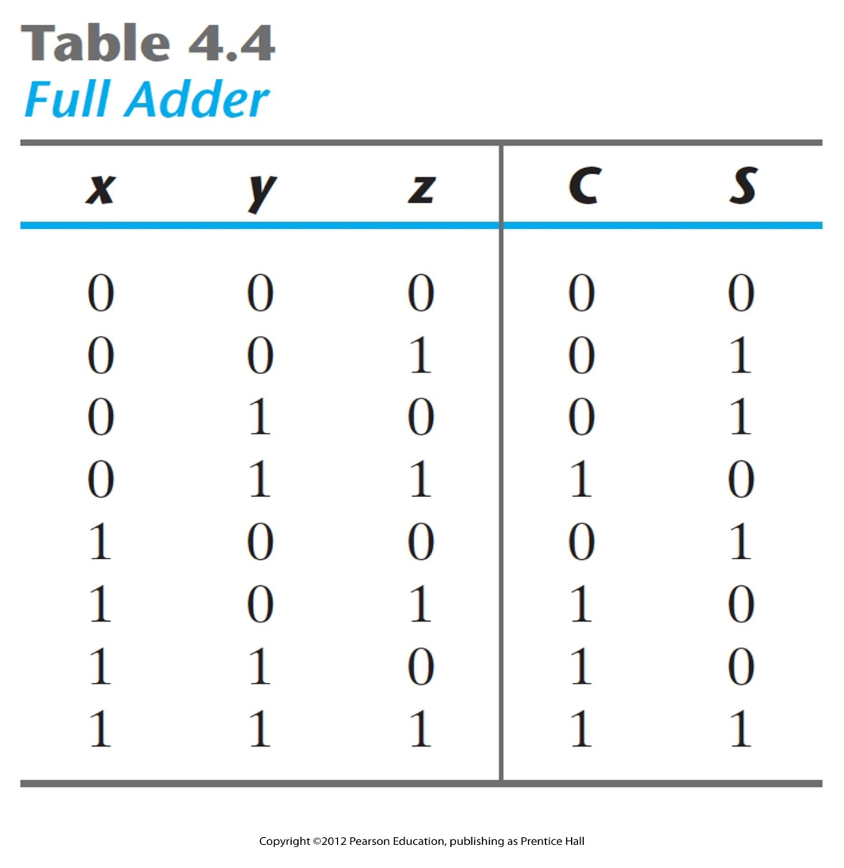
Full Adder

Slide 14
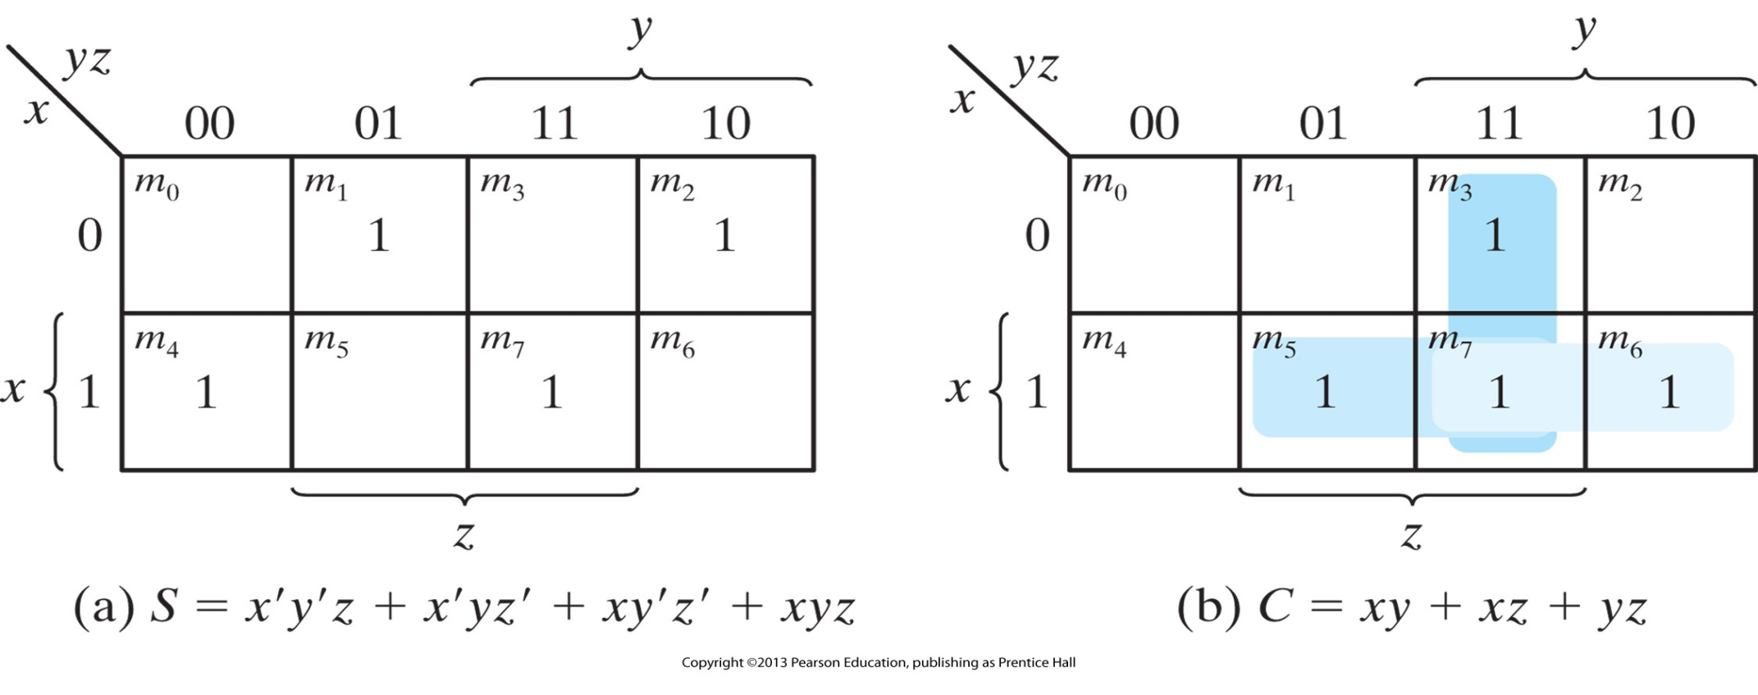
K-Maps for full adder

Slide 15
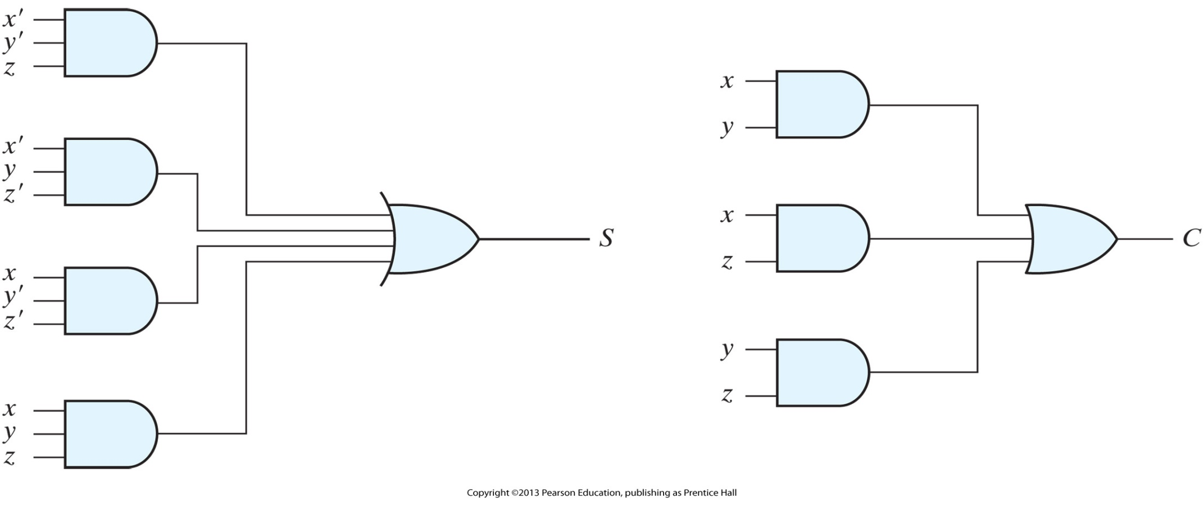
Implementation of full adder in sum-of-products form

Slide 16
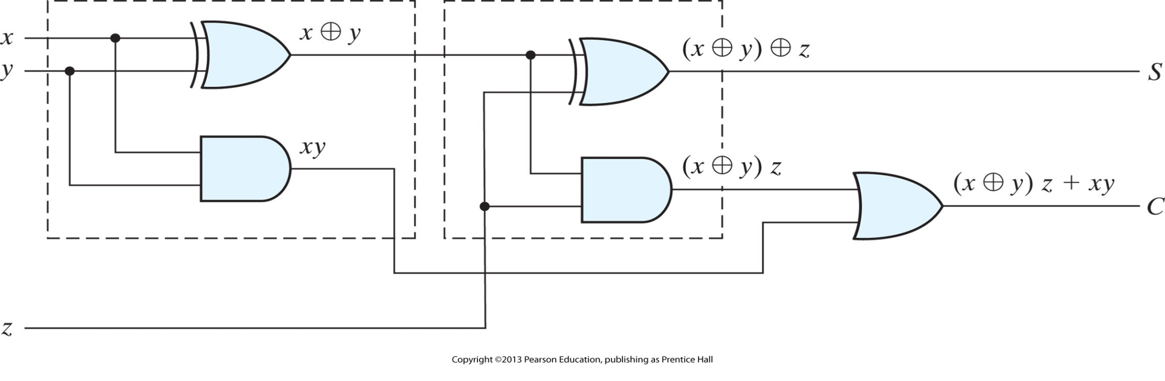
Implementation of full adder with two half adders and an OR gate

Slide 17
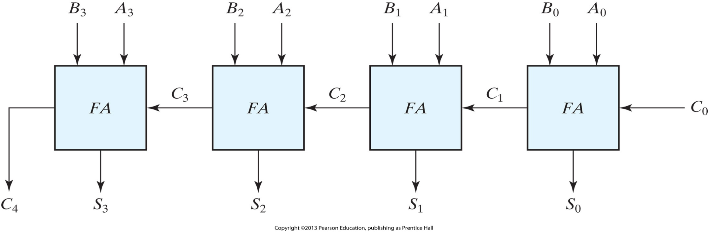
Four-bit adder

Slide 18
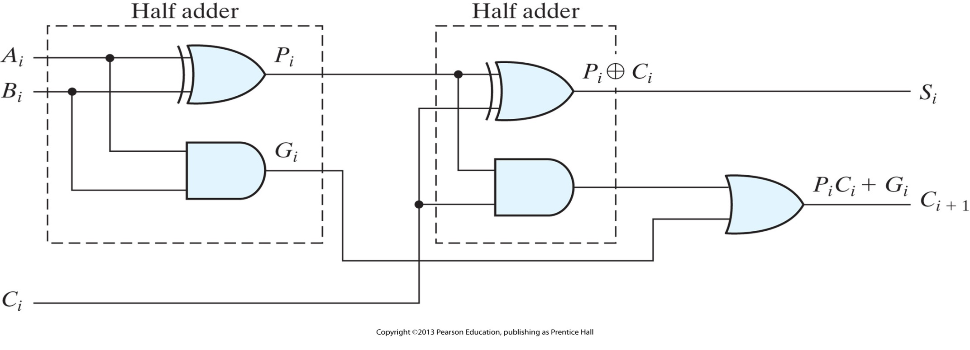
Full adder with P and G shown

Slide 19
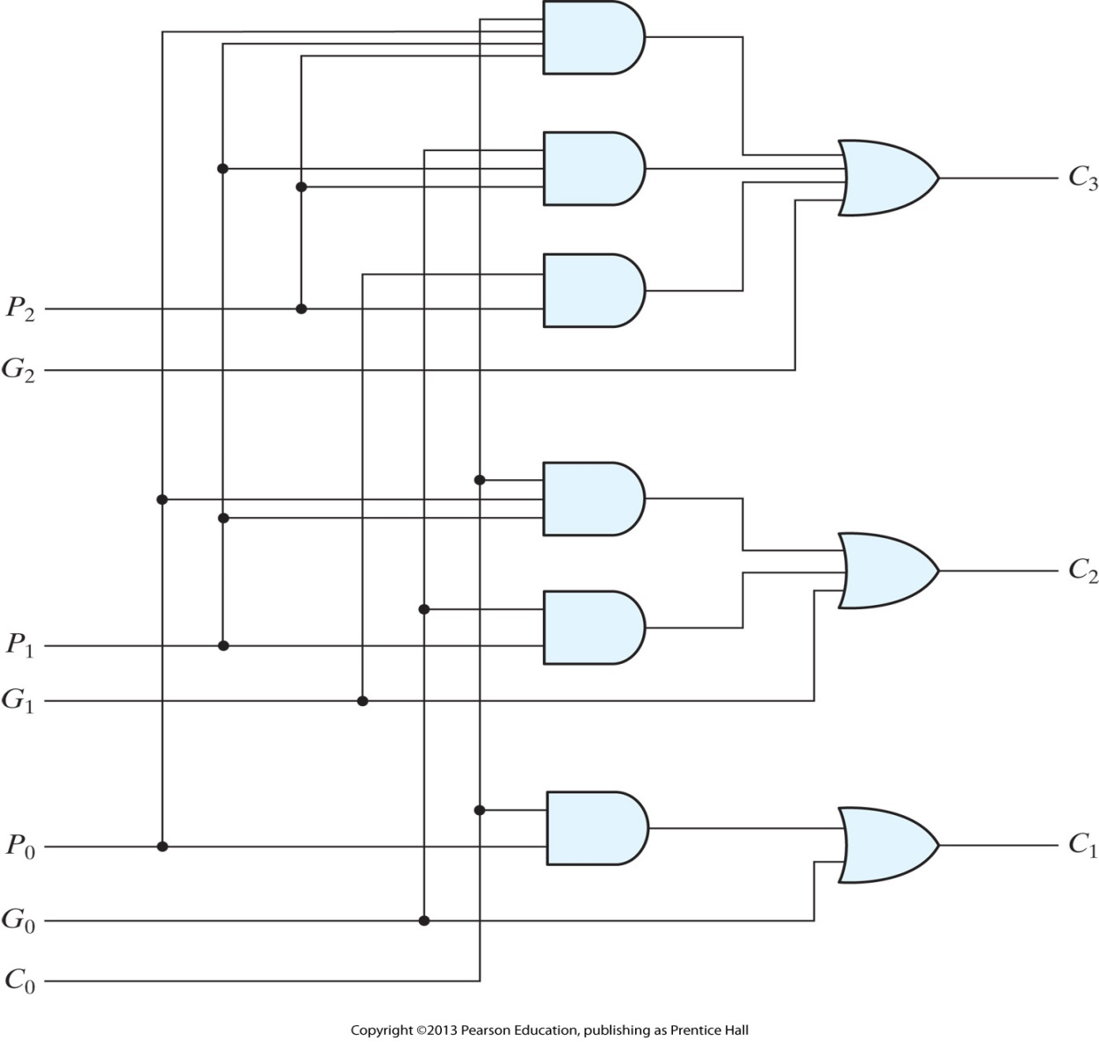
Logic diagram of carry lookahead generator

Slide 20
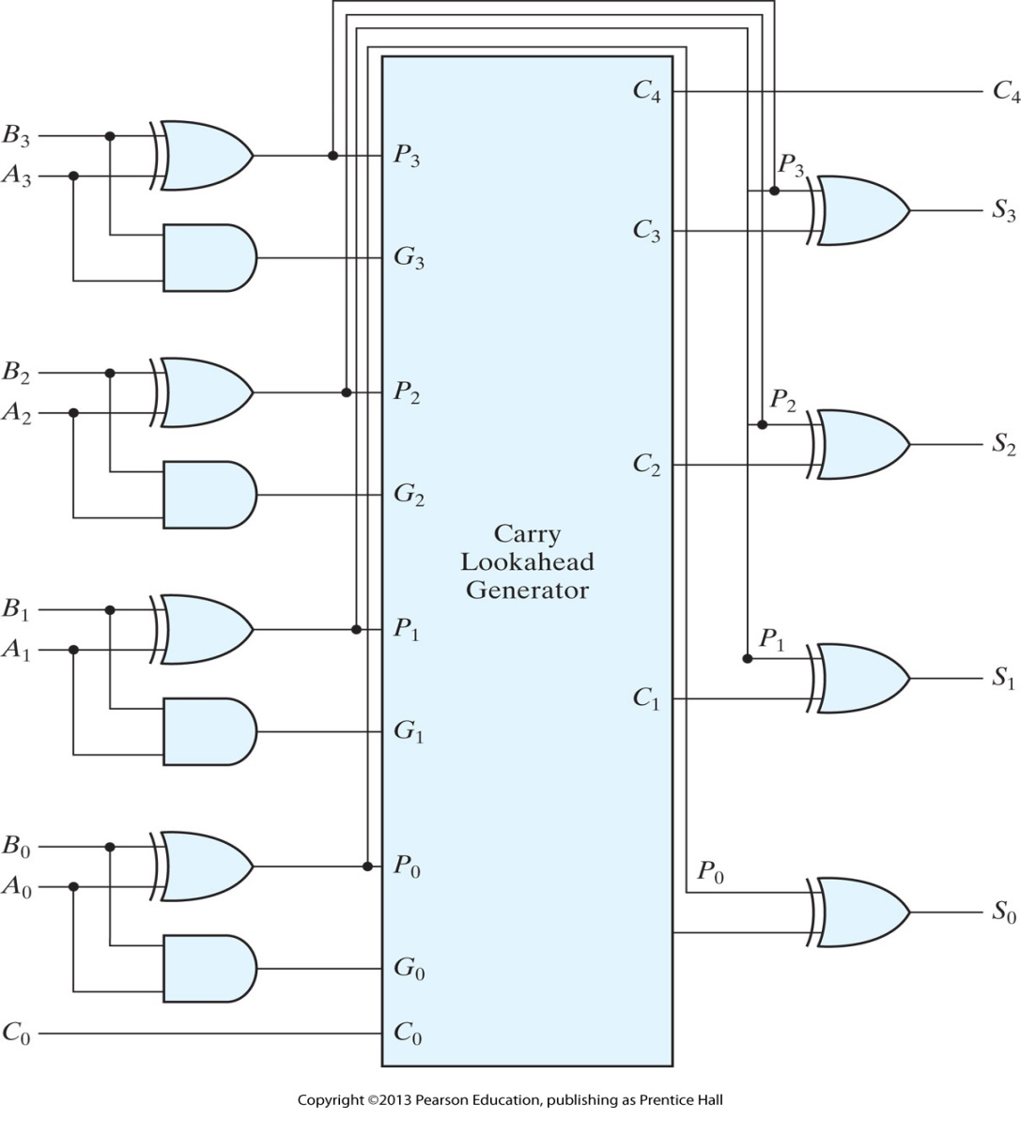
Four-bit adder with carry lookahead

Slide 21
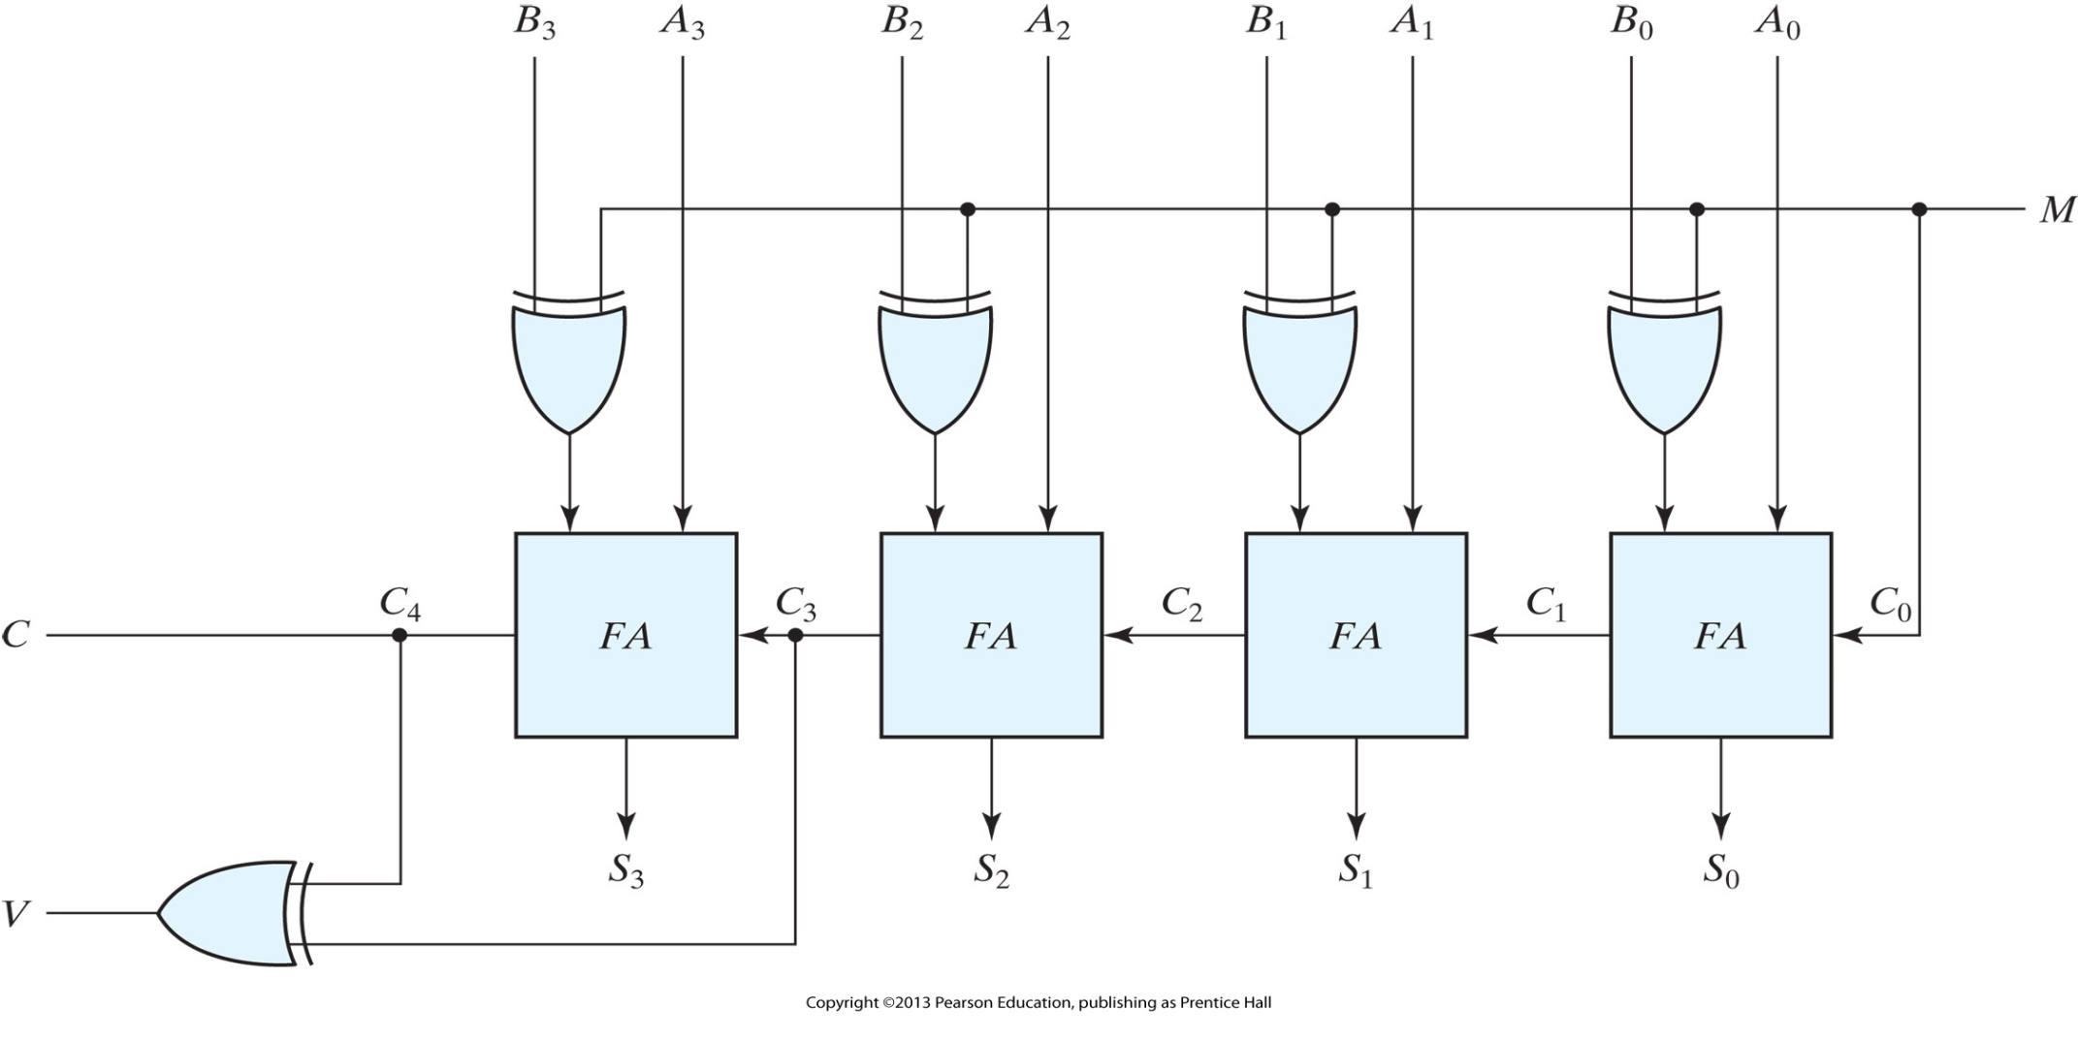
Four-bit adder–subtractor (with overflow detection)

Slide 22
BCD Adder
Consider the arithmetic addition of two decimal digits in BCD, together with an input carry from a previous stage. Since each input digit does not exceed 9, the output sum cannot be greater than 9 + 9 + 1 = 19, the 1 in the sum being an input carry.
Suppose we apply two BCD digits to a four-bit binary adder. The adder will form the sum in binary and produce a result that ranges from 0 through 19. These binary numbers are labeled by symbols K, Z8 , Z4 , Z2 , and Z1 . TABLE IN NEXT SLIDE
K is the carry, and the subscripts under the letter Z represent the weights 8, 4, 2, and 1 that can be assigned to the four bits in the BCD code.
The columns under the binary sum list the binary value that appears in the outputs of the four-bit binary adder. The output sum of two decimal digits must be represented in BCD and should appear in the form listed in the columns under “BCD Sum.” The problem is to find a rule by which the binary sum is converted to the correct BCD digit representation of the number in the BCD sum. In examining the contents of the table, it becomes apparent that when the binary sum is equal to or less than 1001, the corresponding BCD number is identical, and therefore no conversion is needed. When the binary sum is greater than 1001, we obtain an invalid BCD representation. The addition of binary 6 (0110) to the binary sum converts it to the correct BCD representation and also produces an output carry as required.

Slide 23
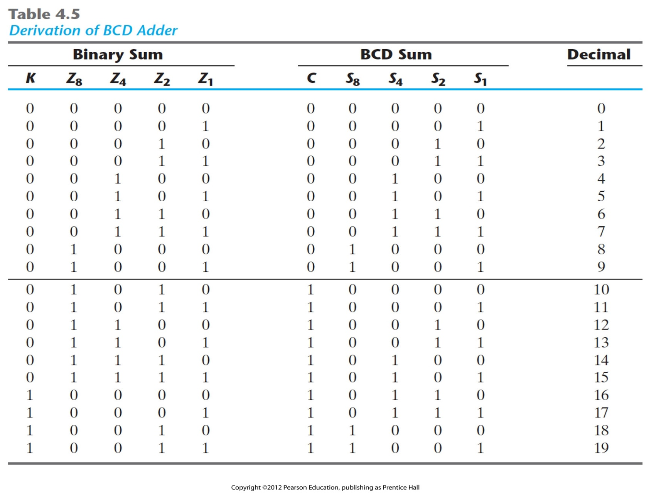
Derivation of BCD Adder

Slide 24
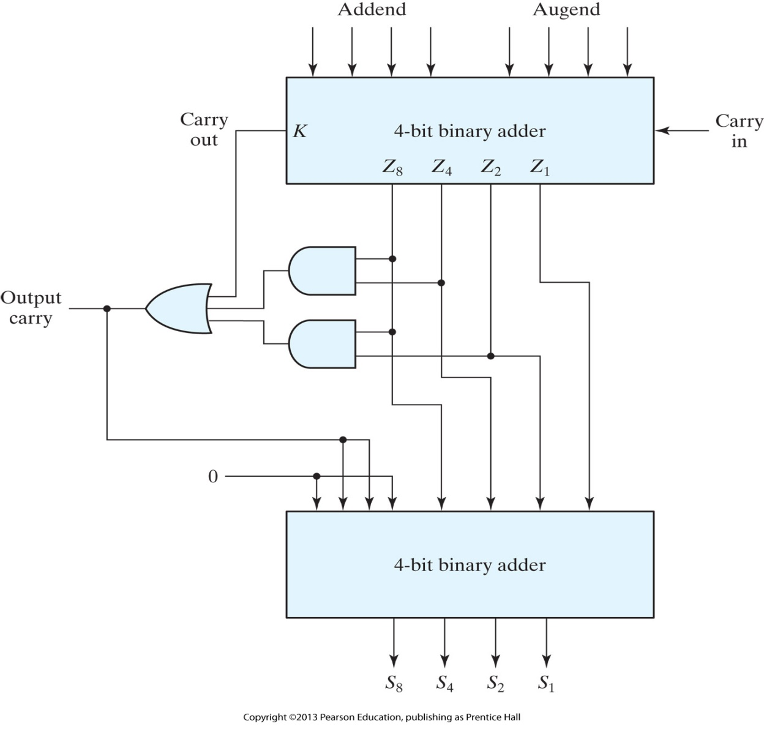
Block diagram of a BCD adder

Slide 25
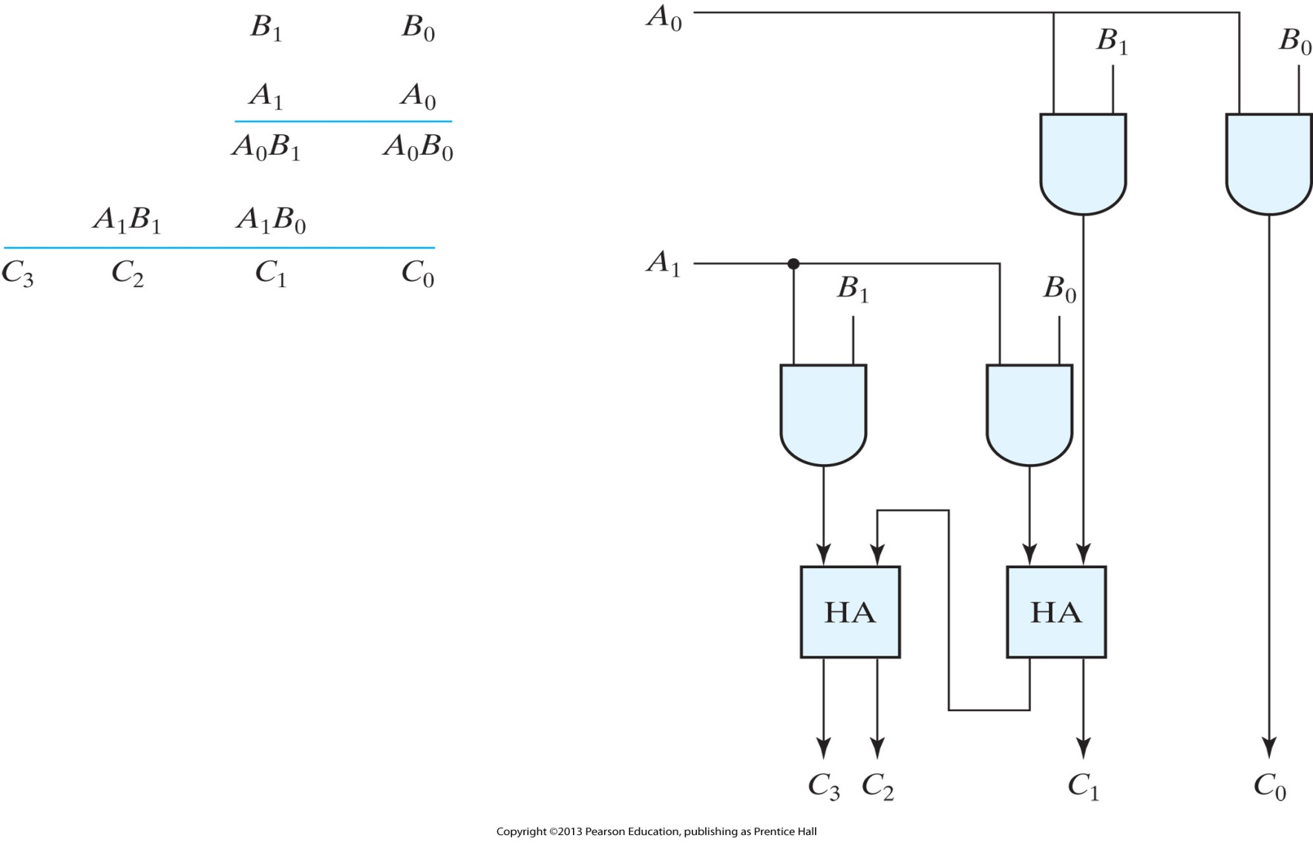
Two-bit by two-bit binary multiplier

Slide 26
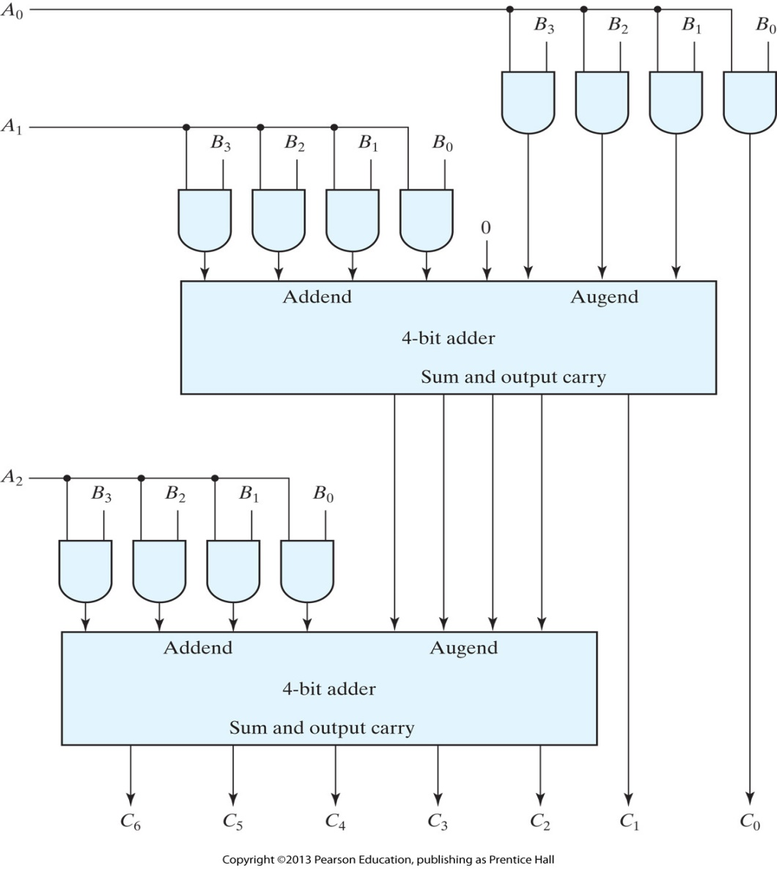
Four-bit by three-bit binary multiplier

Slide 27
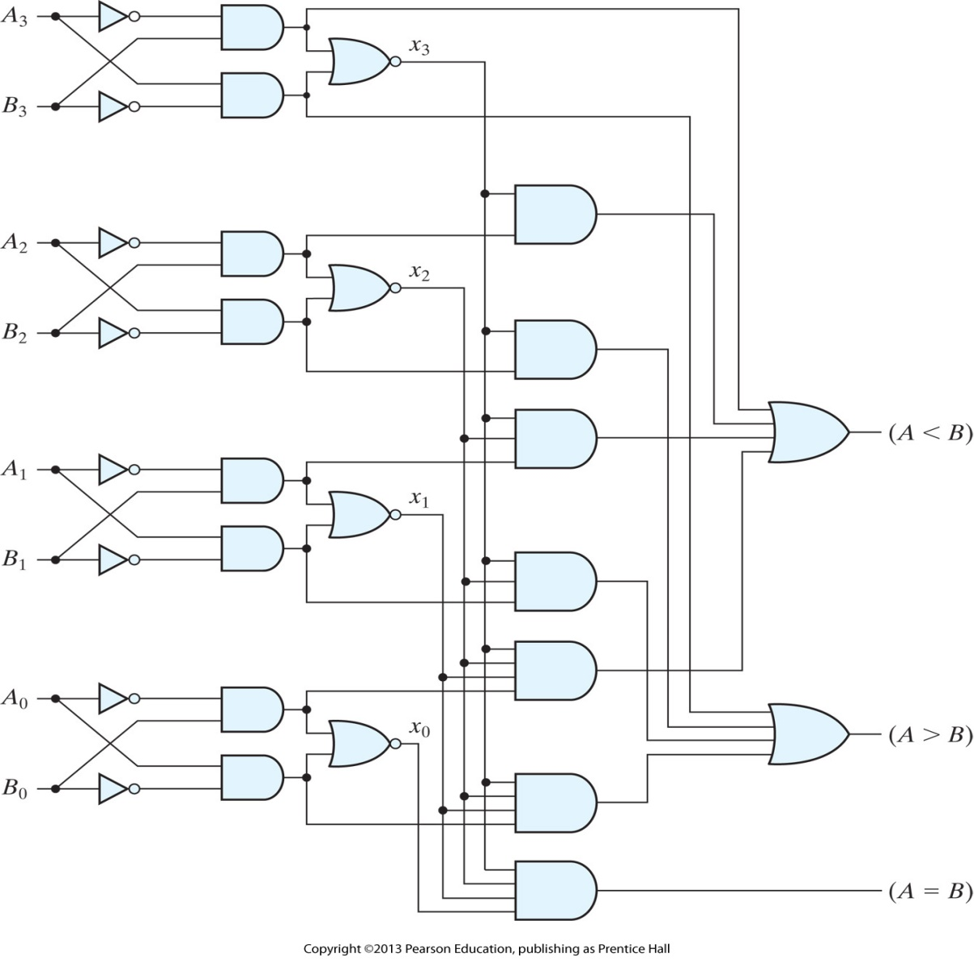
Four-bit magnitude comparator
Take 2 n-bit numbers and produce 1 if they are equal and 0 otherwise
Q: Derive the truth table for a 4-bit comparator, simplify the Boolean function and draw the logic diagram. Is the diagram similar to the one below? Try to use Boolean algebra to make your circuit similar to that below.

Slide 28
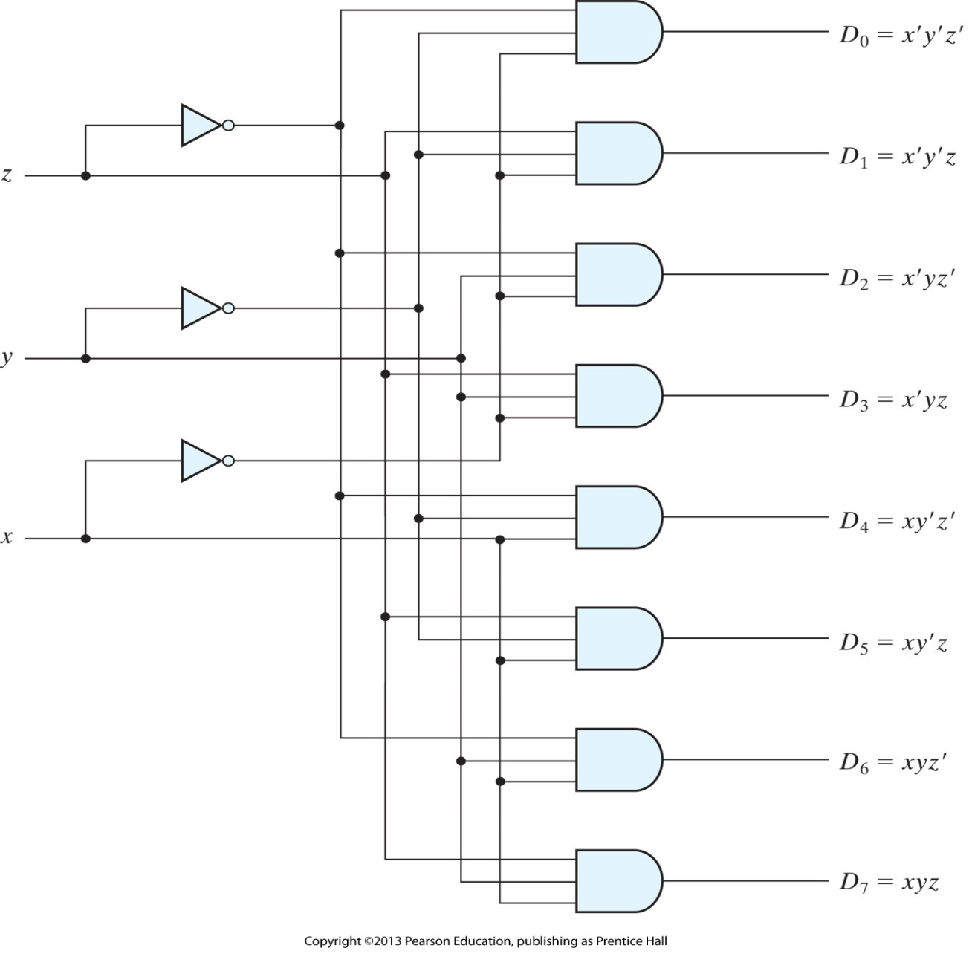
Three-to-eight-line decoder
Takes an n-bit number as input and uses it to select exactly one of the 2^{n} outputs

Slide 29
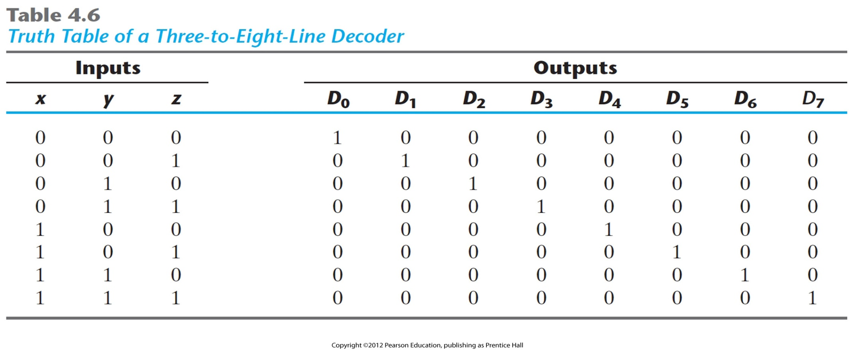
Truth Table of a Three-to-Eight-Line Decoder

Slide 30
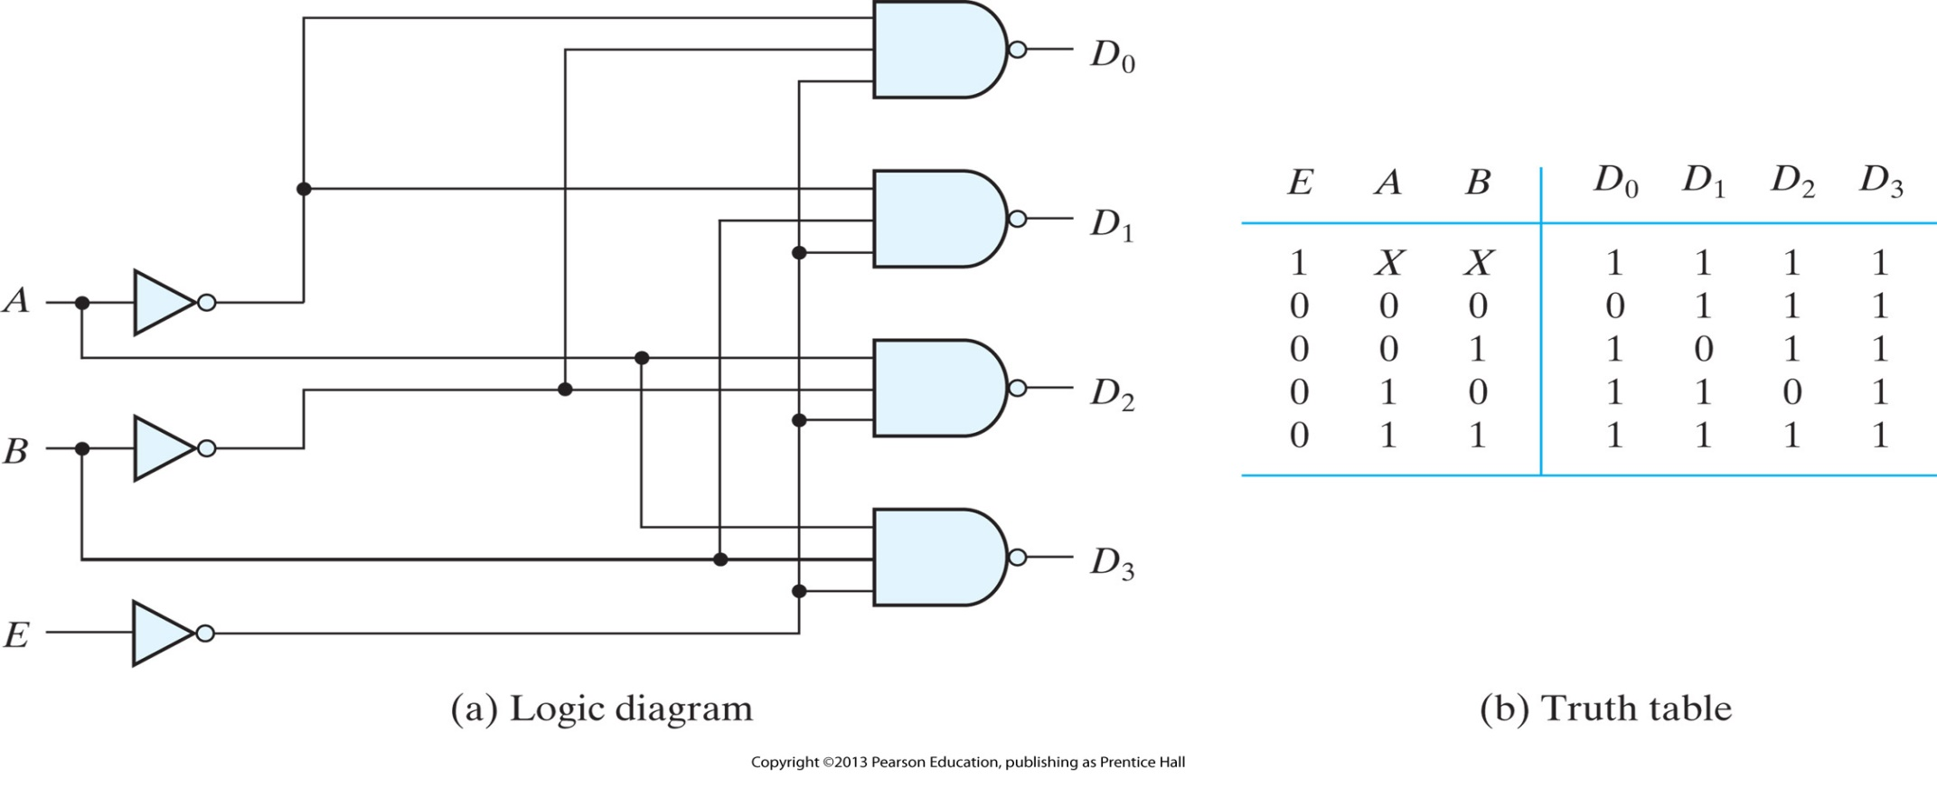
Two-to-four-line decoder with enable input

Slide 31
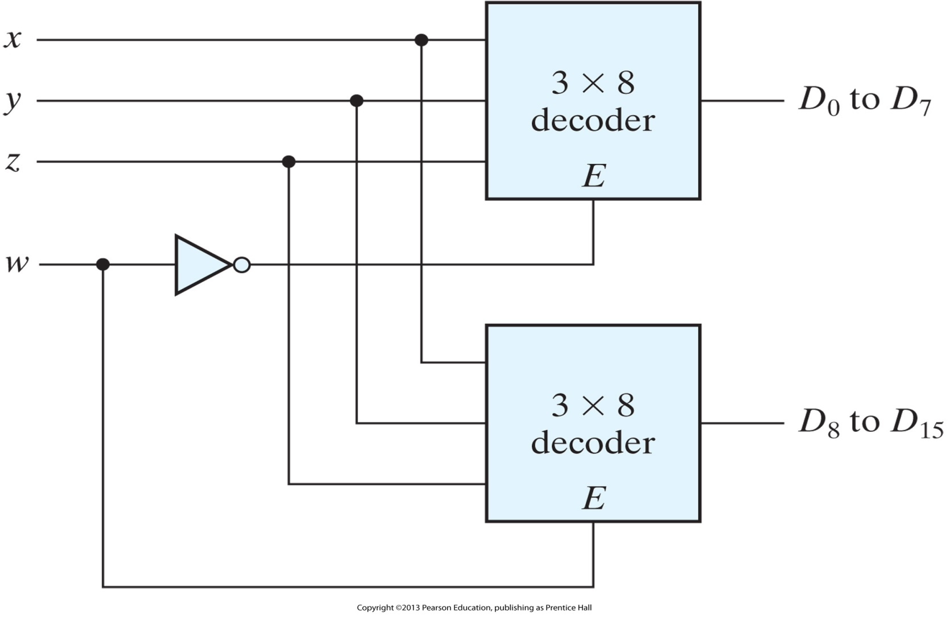
4 × 16 decoder constructed with two 3 × 8 decoders

Slide 32
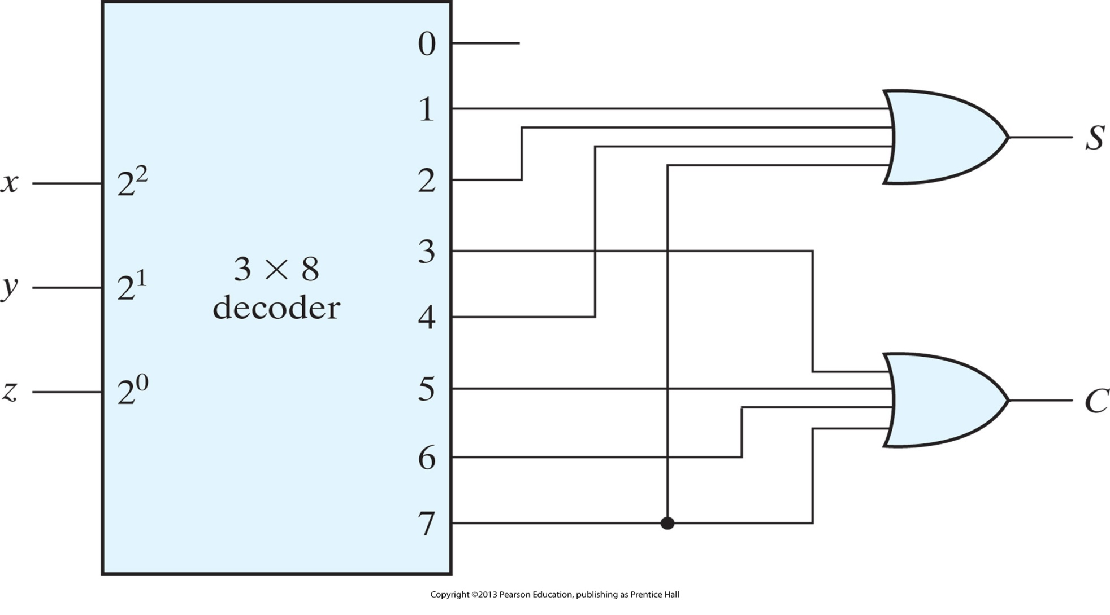
Implementation of a full adder with a decoder

Slide 33
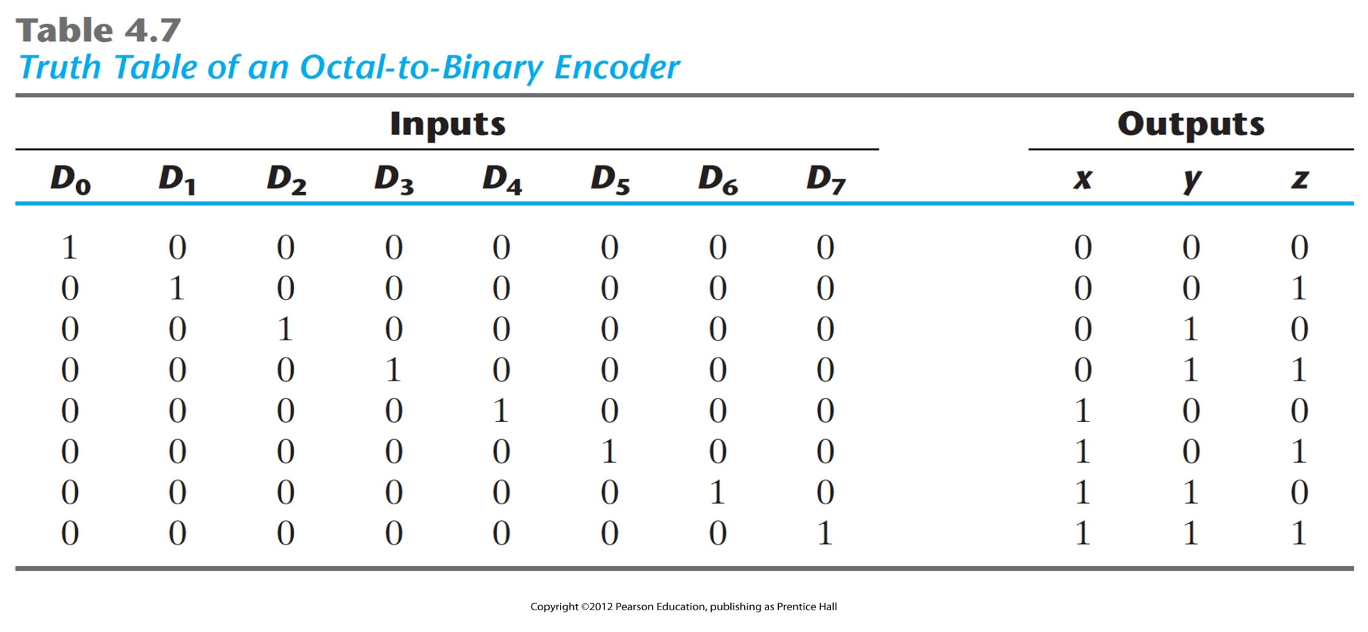
Truth Table of an Octal-to-Binary Encoder

Slide 34
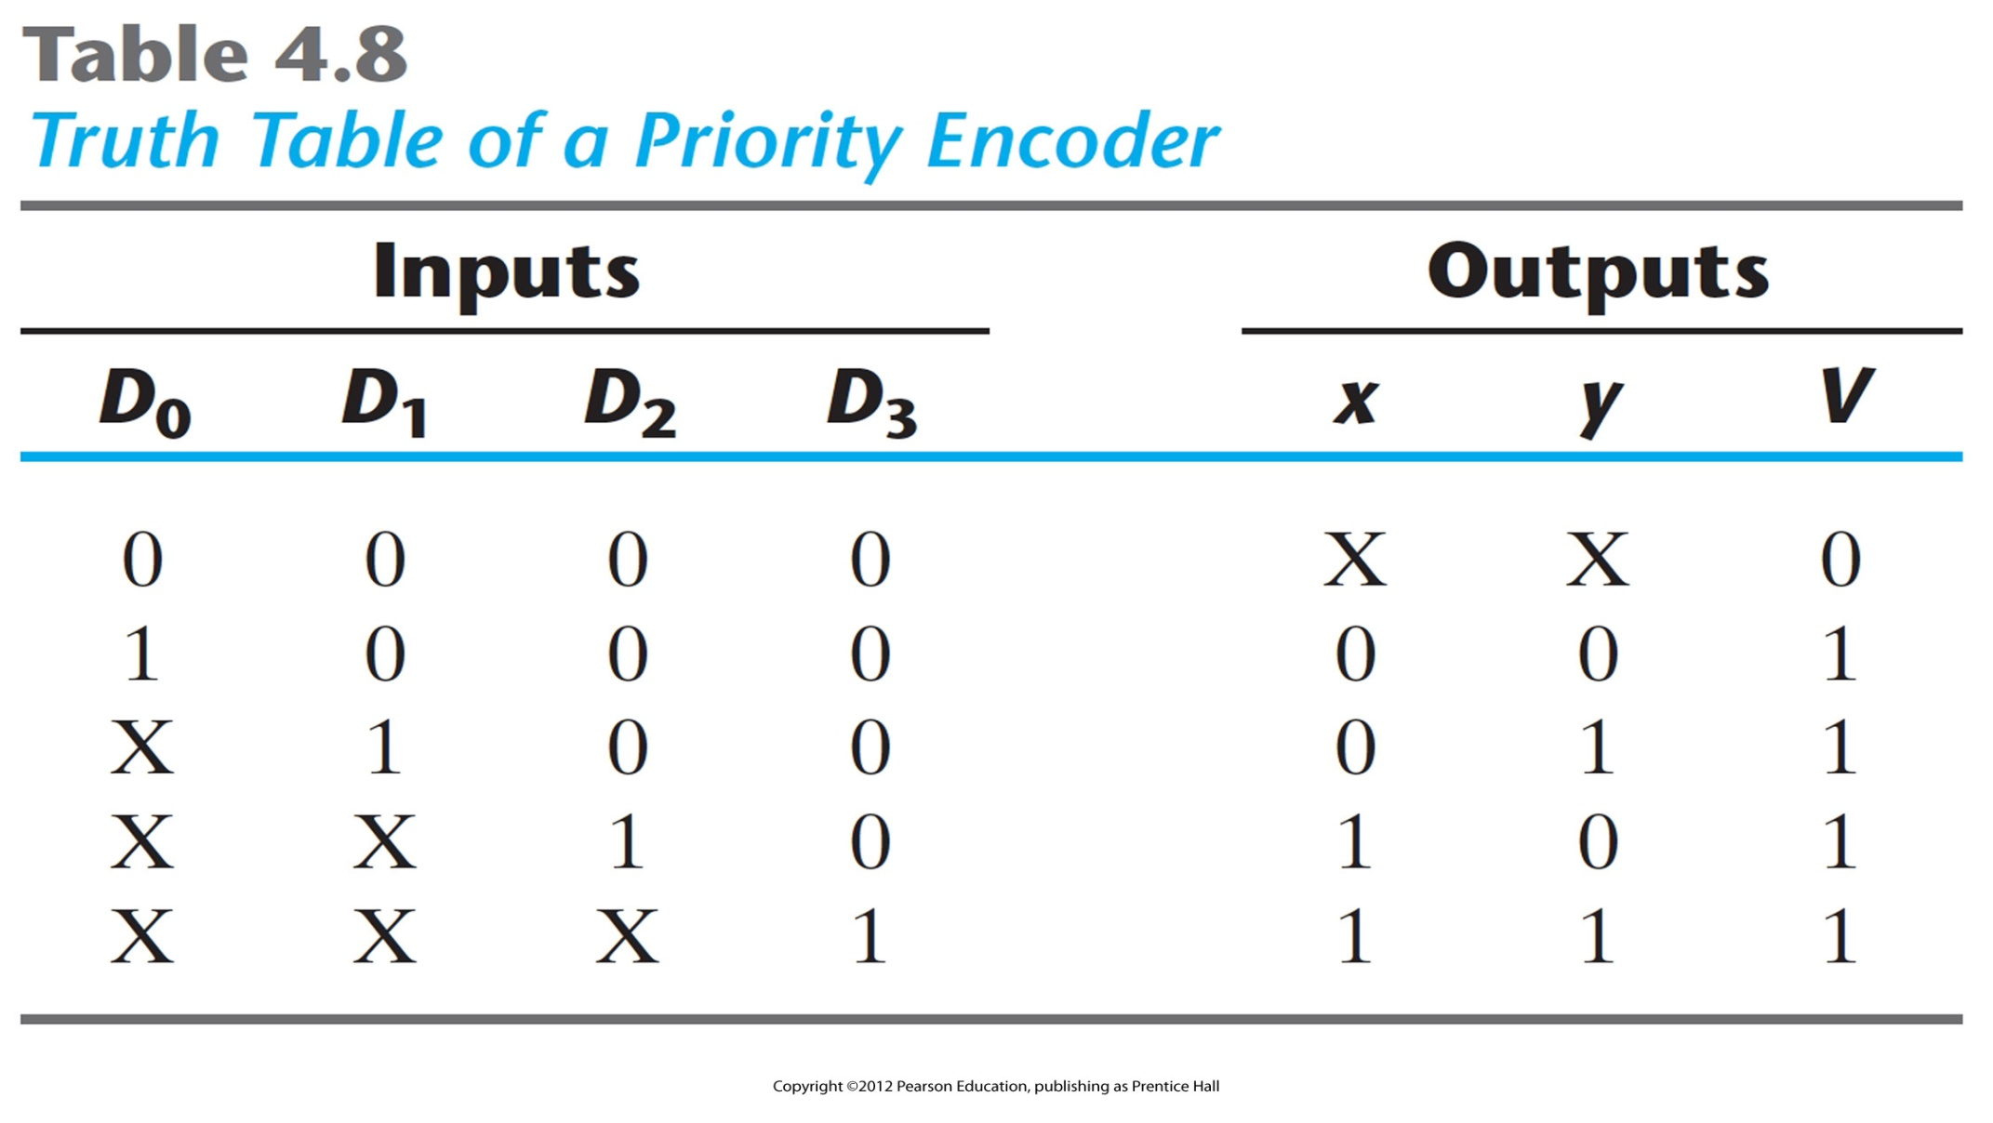
Truth Table of a Priority Encoder

Slide 35
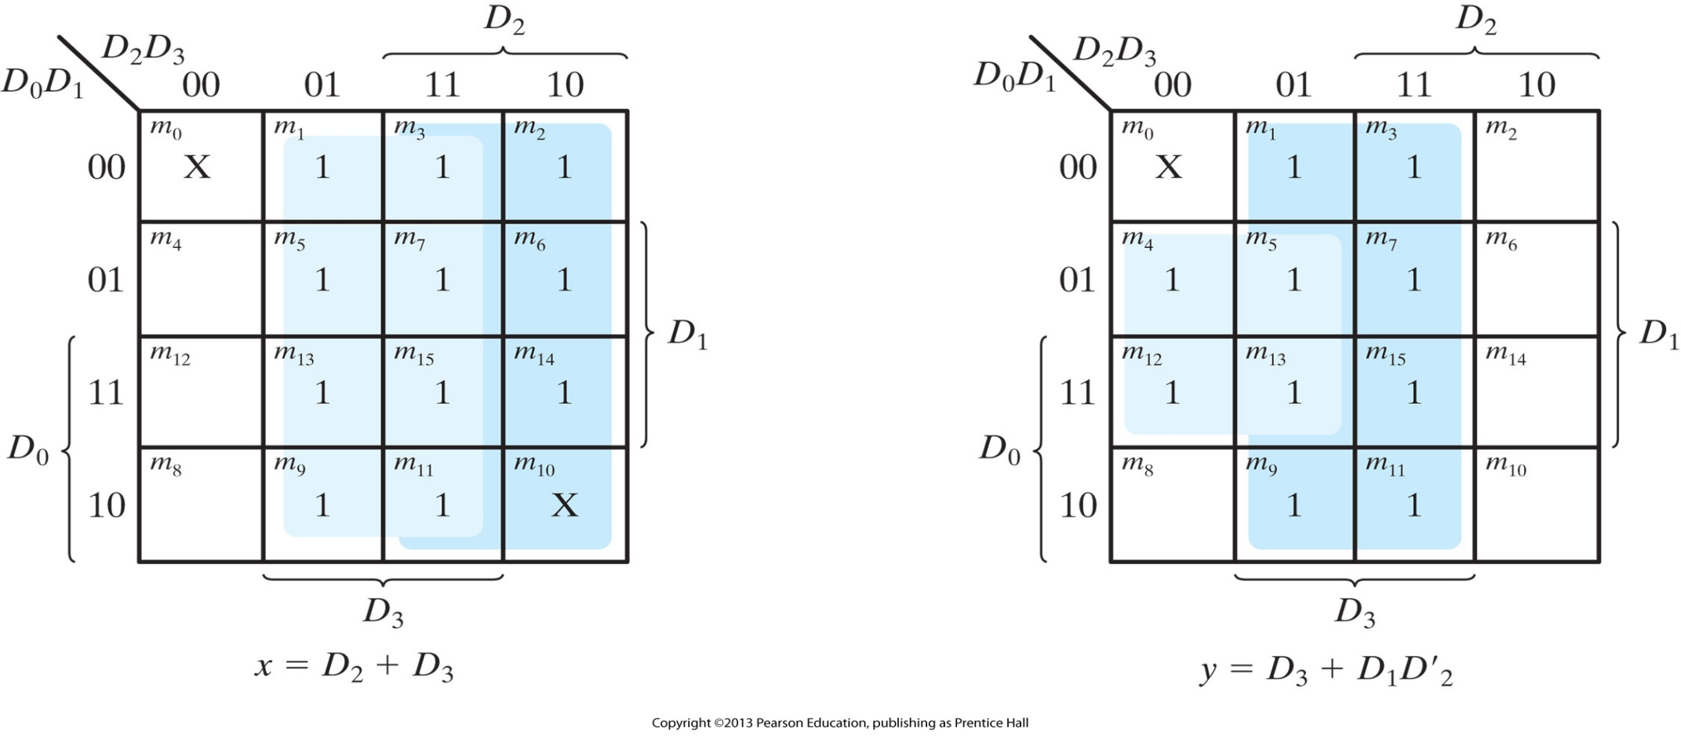
Maps for a priority encoder

Slide 36
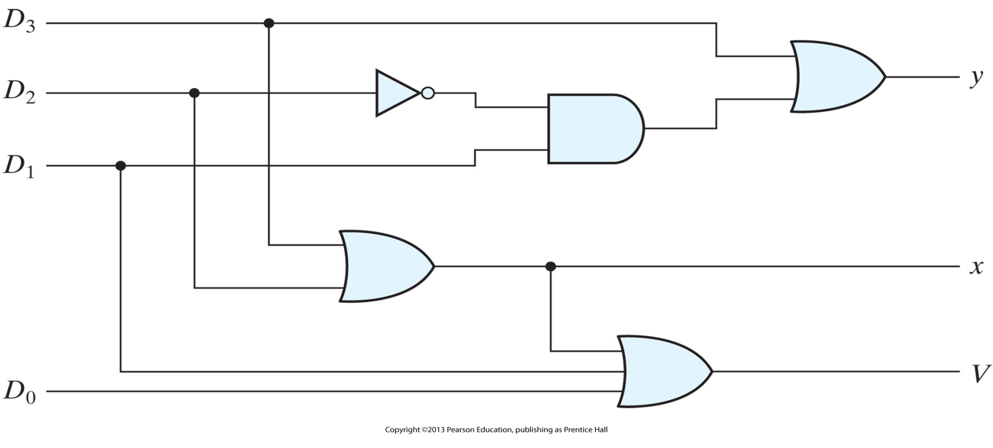
Four-input priority encoder

Slide 37
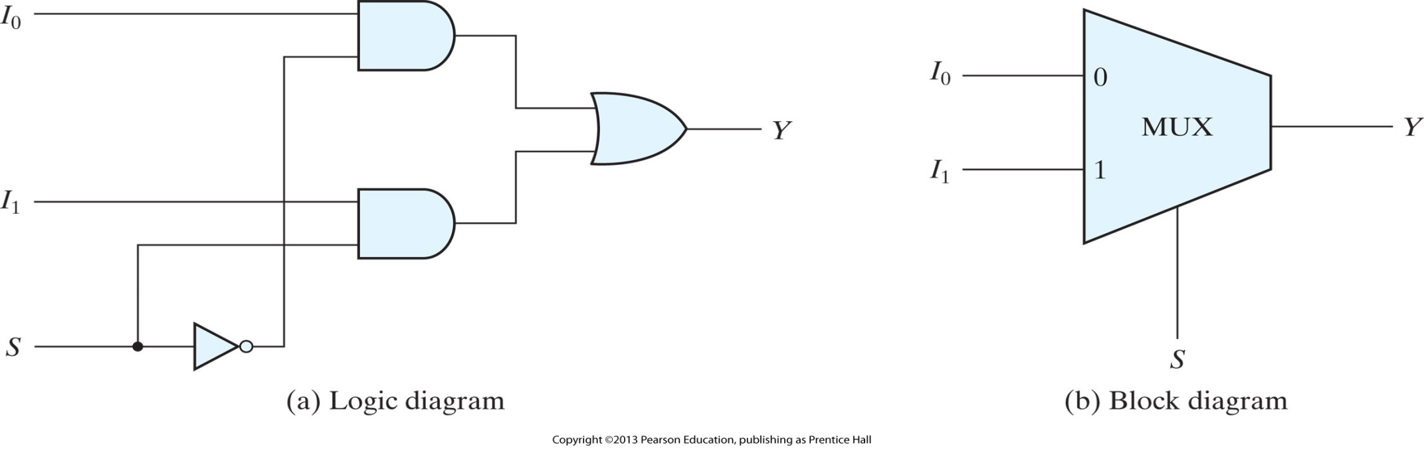
Two-to-one-line multiplexer
2^{n} inputs, 1 output, n control inputs
Q: Derive the truth table for the multiplexer in the figure below
Q: Can you think of a way to use the multiplexer in order to implement
a parallel-to-serial converter
the majority function?

Slide 38
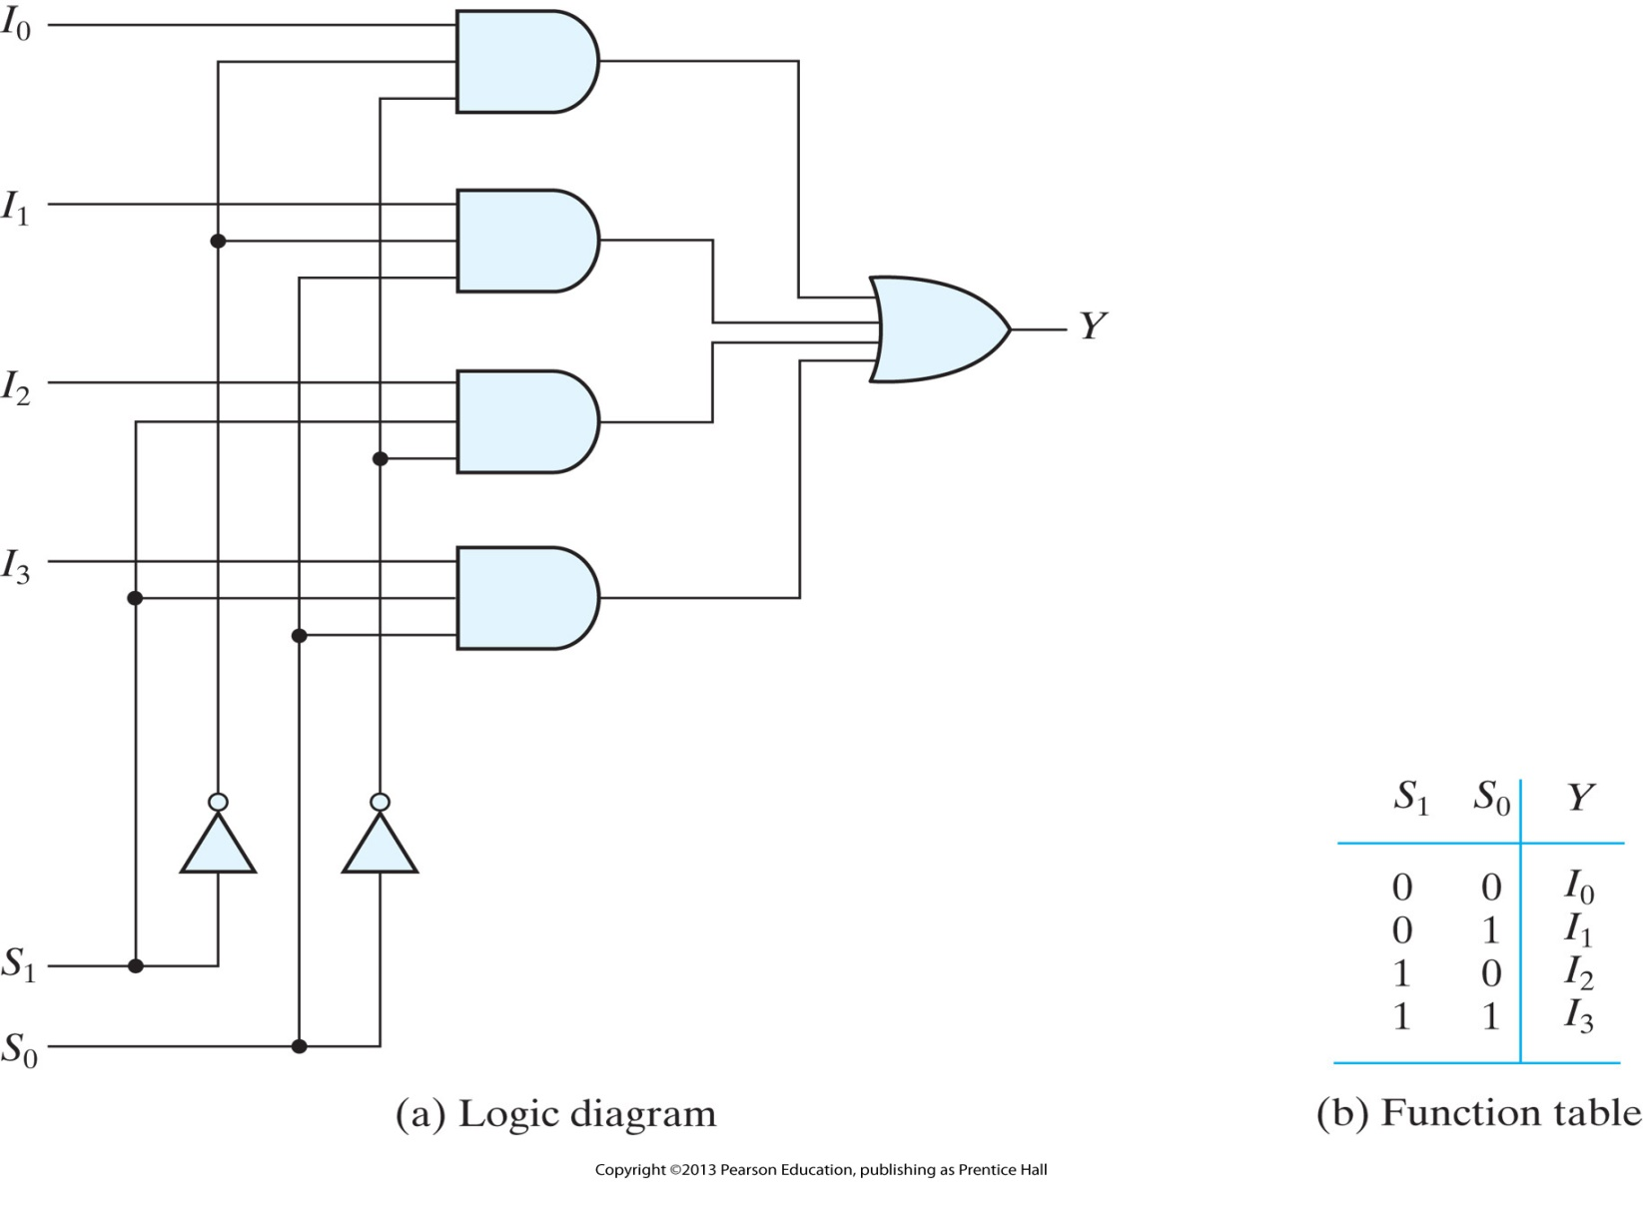
Four-to-one-line multiplexer

Slide 39
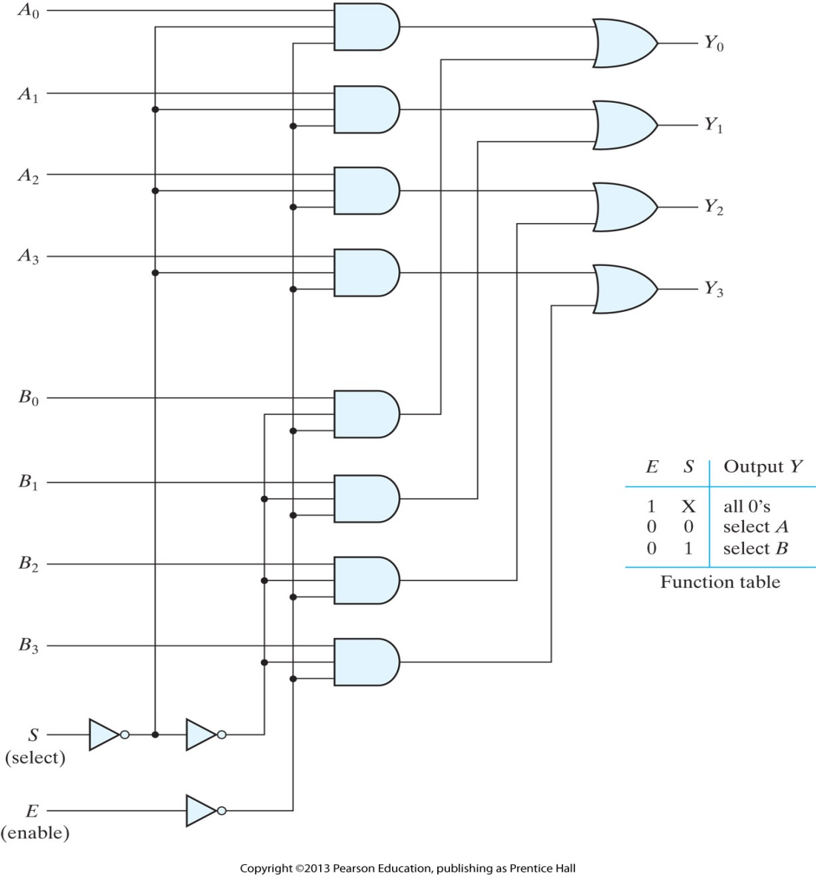
Quadruple two-to-one-line multiplexer

Slide 40
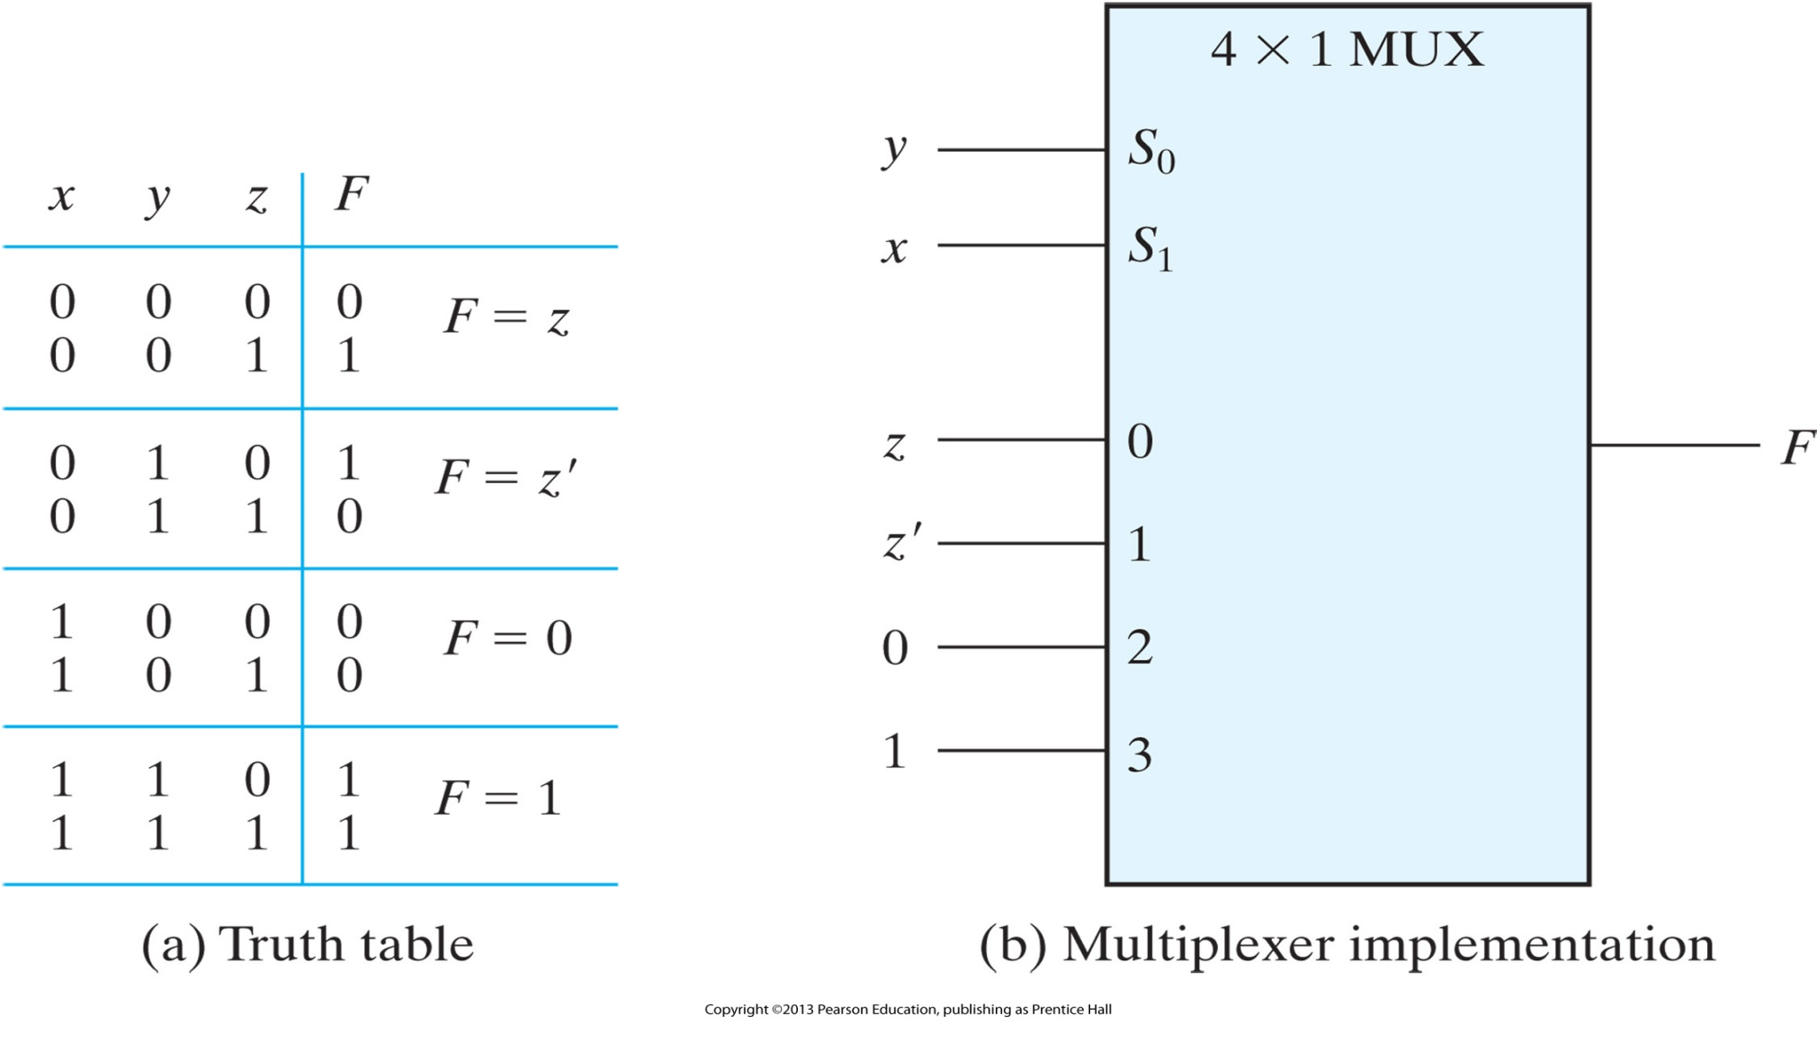
Implementing a Boolean function with a multiplexer

Slide 41
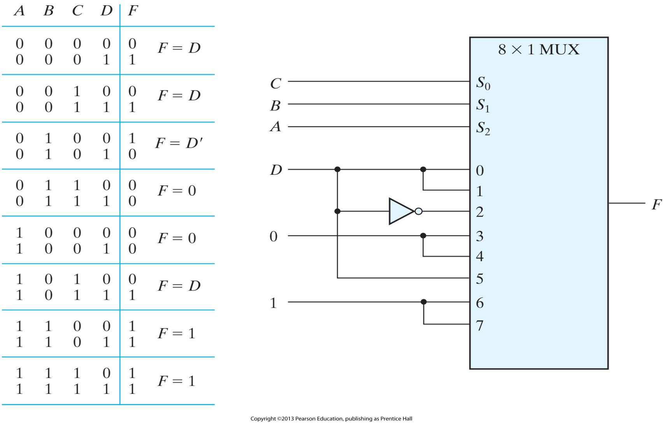
Implementing a four-input function with a multiplexer

Slide 42
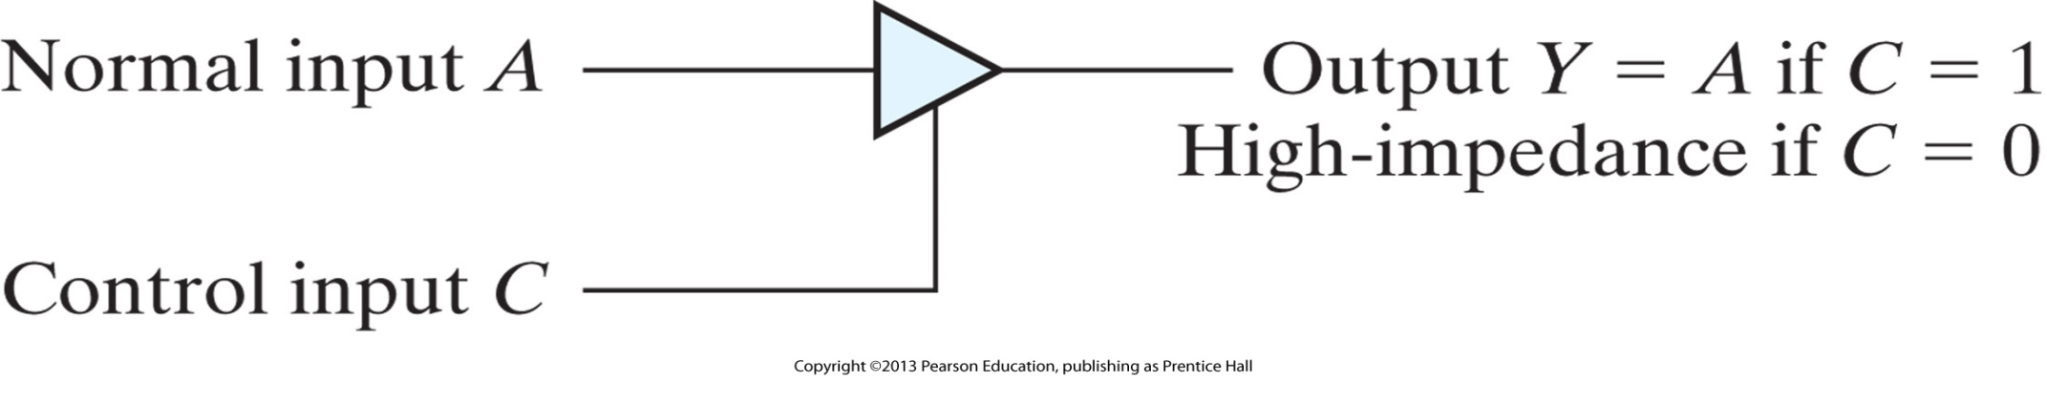
Graphic symbol for a three-state buffer

Slide 43
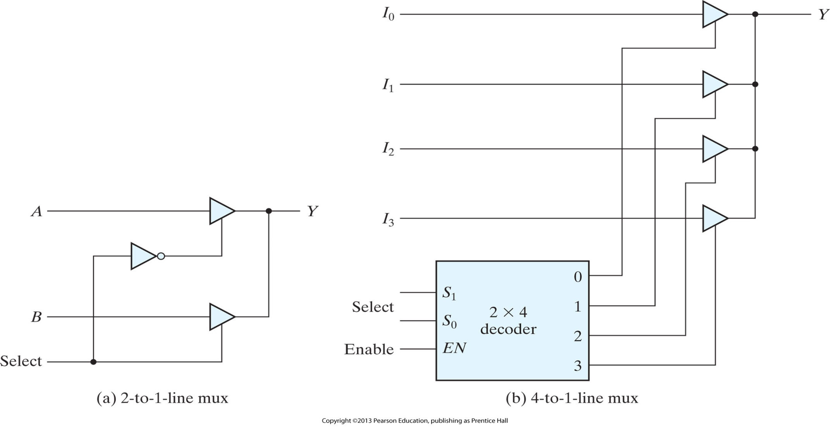
Multiplexers with three-state gates

Slide 44


